Slide 1
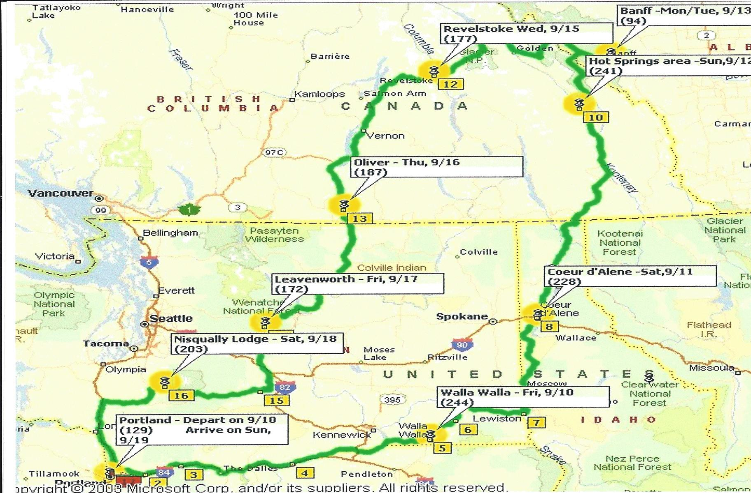
Oregon CCCA Mini Tour To Banff
2004

Slide 2
Members on tour:
Rodger & Jan
John & Mandy
Bob & Franky
Jerry & June
Howard & Evelyn
Bev & Daryl
Hurley York
Aloma & Bill
George & Sylvia
Gary & Myrna
Dan & Gracy
Bob & Carol
Gene & lois
Full Classic’s on tour:
1927 Stutz
1932 Lincoln
1932 Studebaker
1938 Packard
Cadillac
1941 Packard
1941 Cadillac
We depart from Elmer’s in Portland

Slide 3
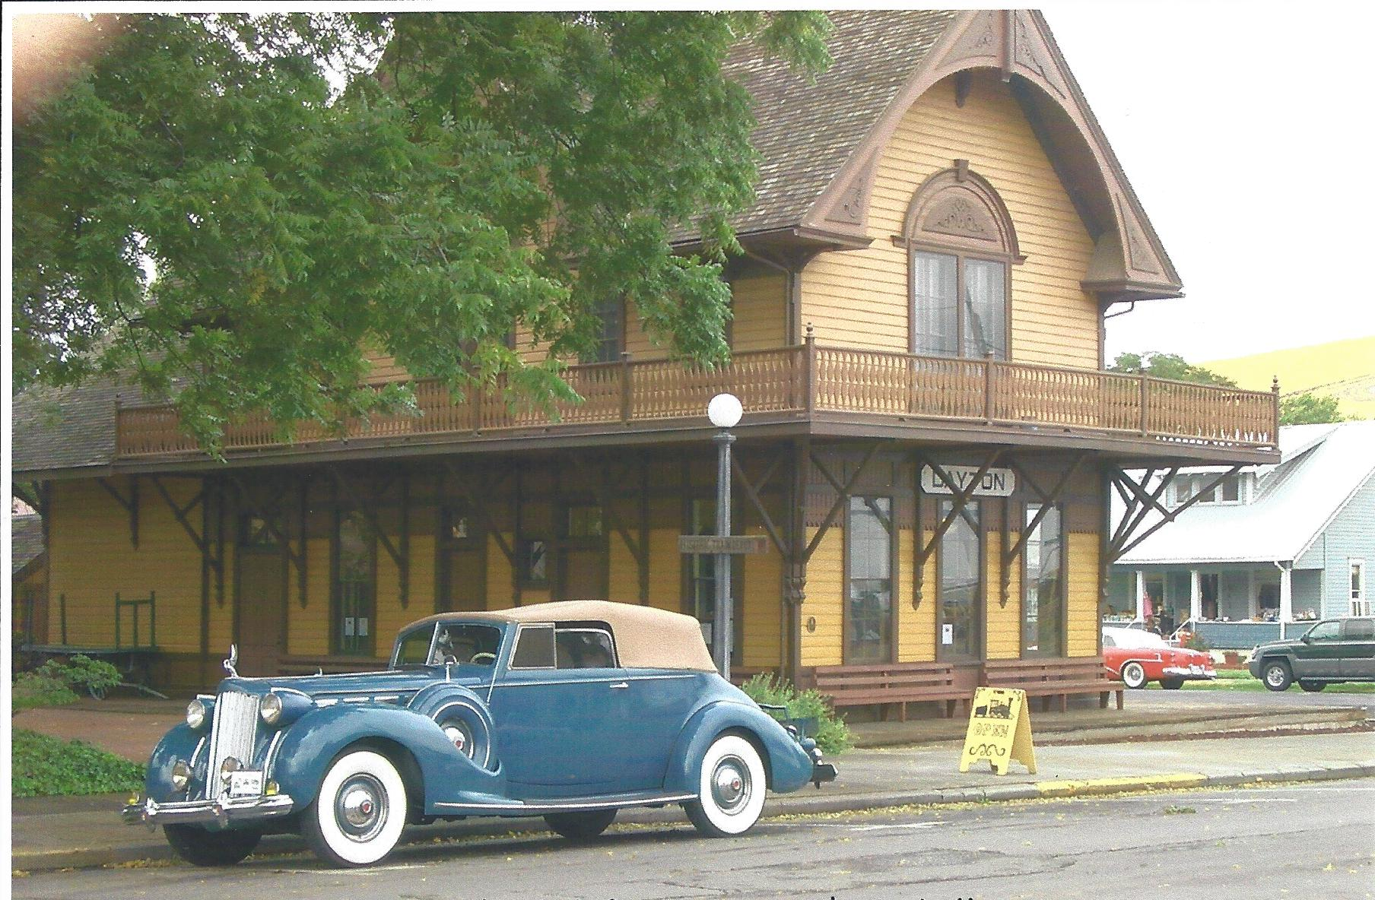
Our stop Dayton, OR

Slide 4
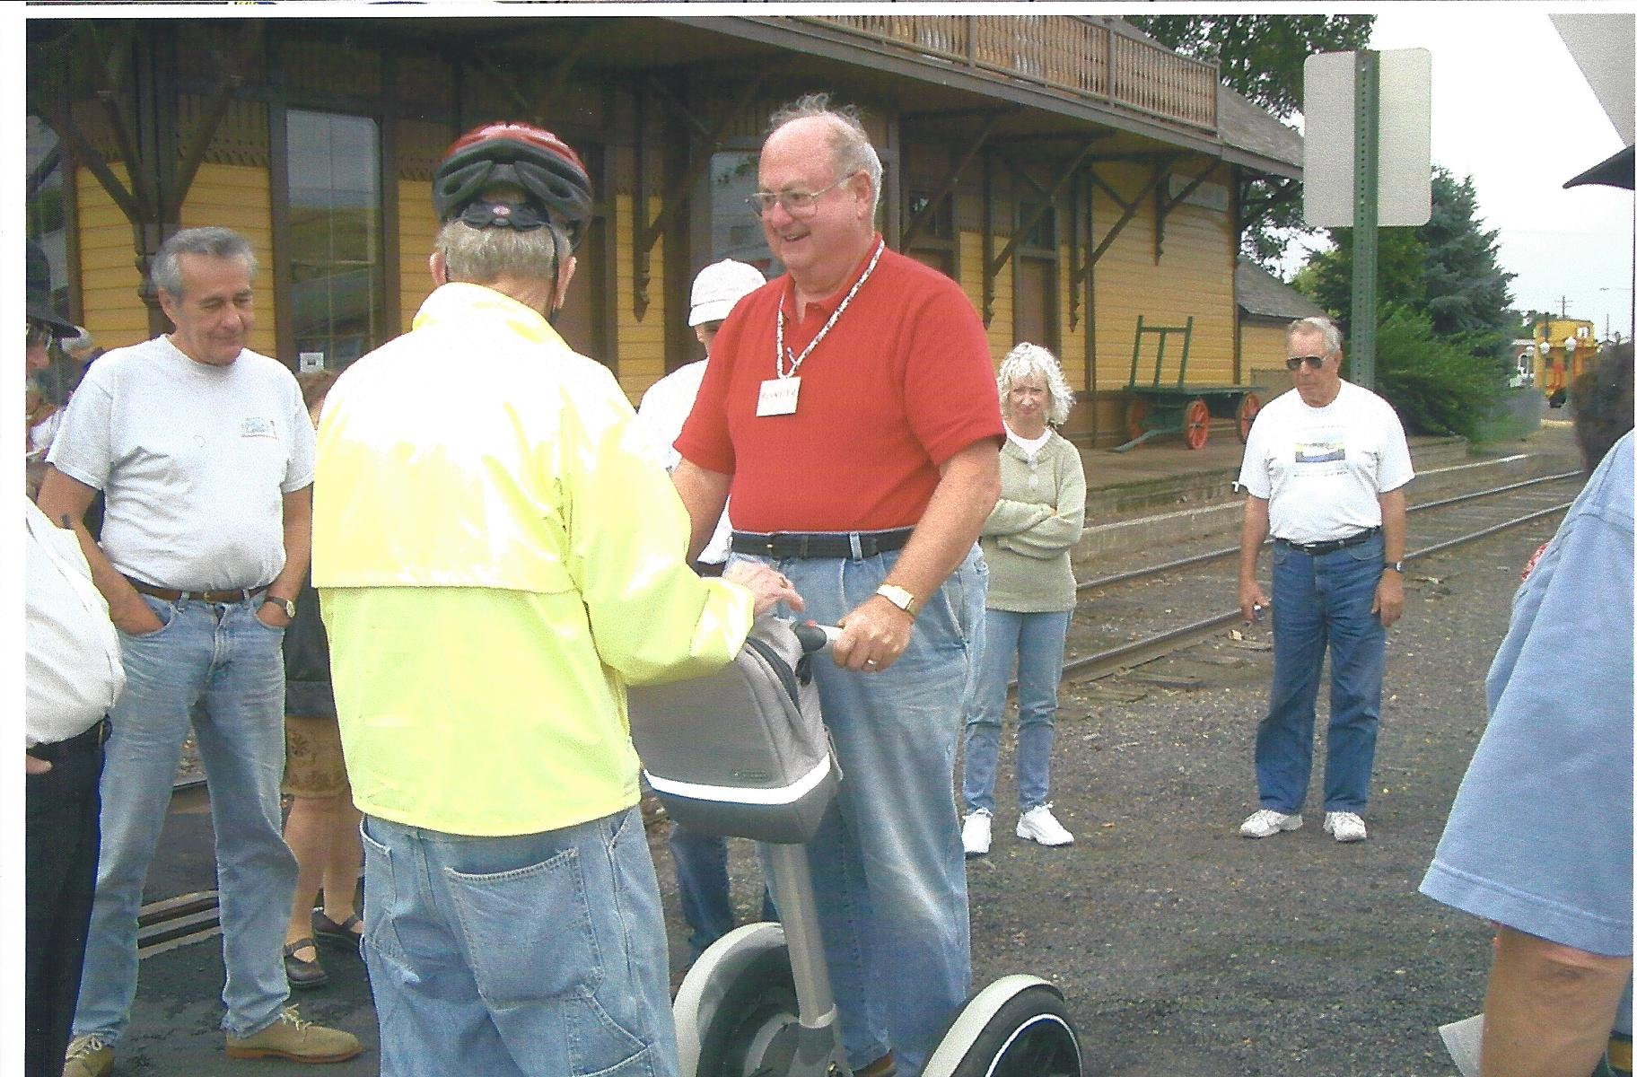
Howard takes a ride on a Segway in Dayton, OR

Slide 5
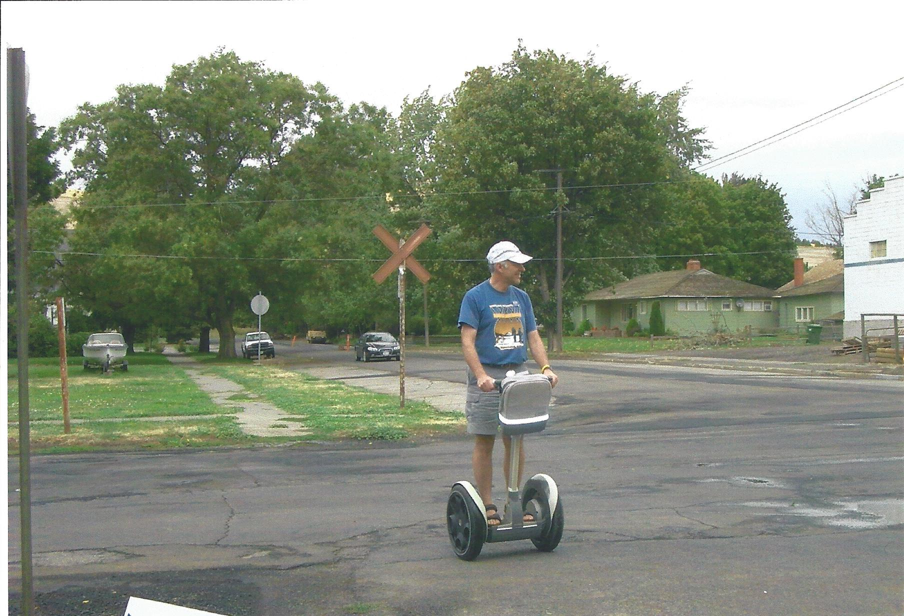
Who needs a car when you have a Segway

Slide 6
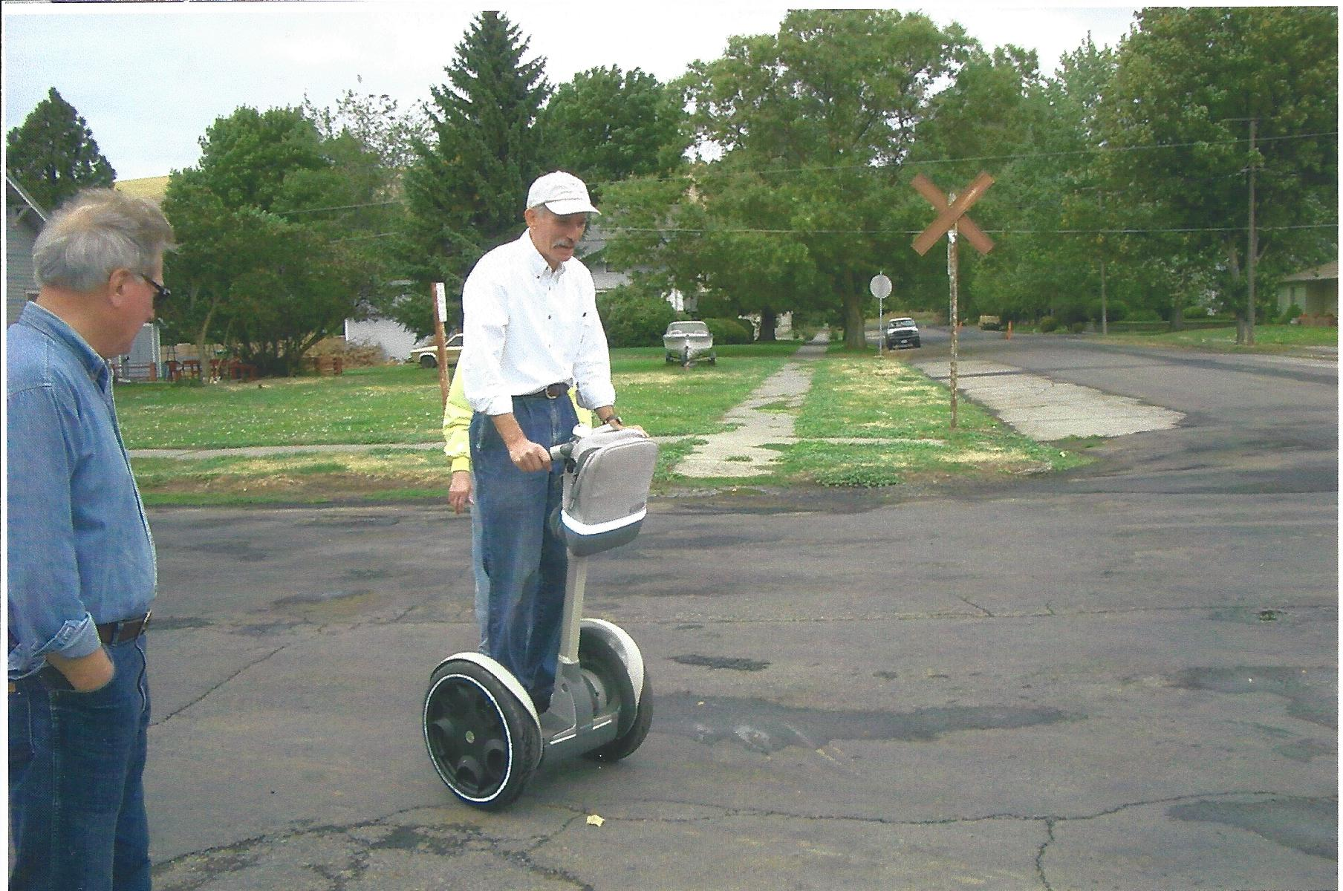
Bob Douglas is next up

Slide 7
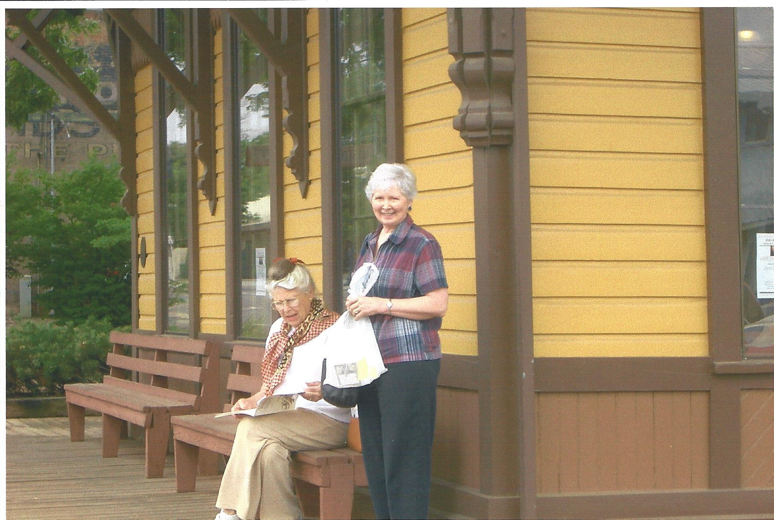
Beverly Smith and Sylvia Potter

Slide 8
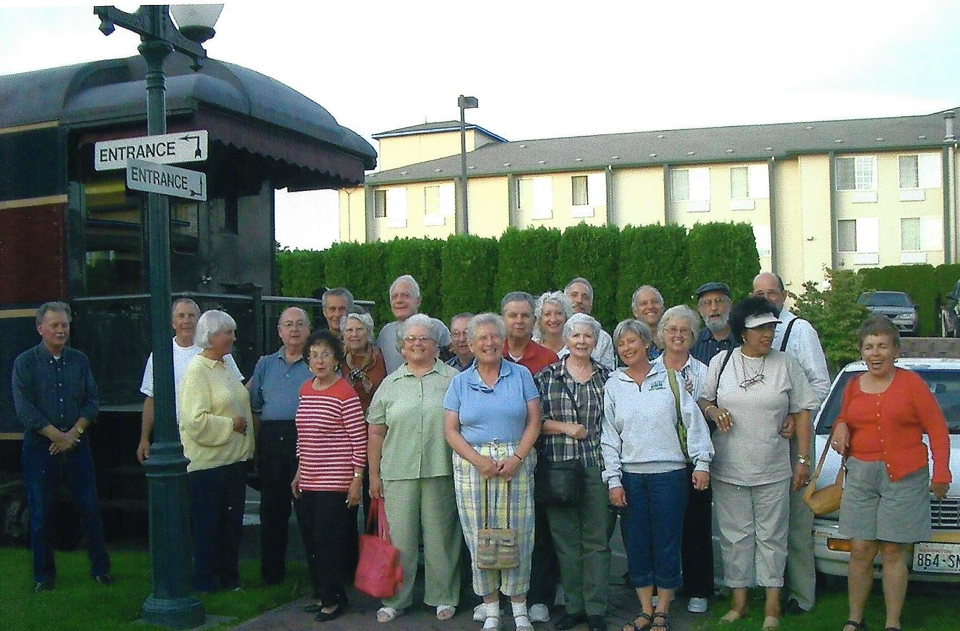
Dinner in Walla Walla, WA

Slide 9
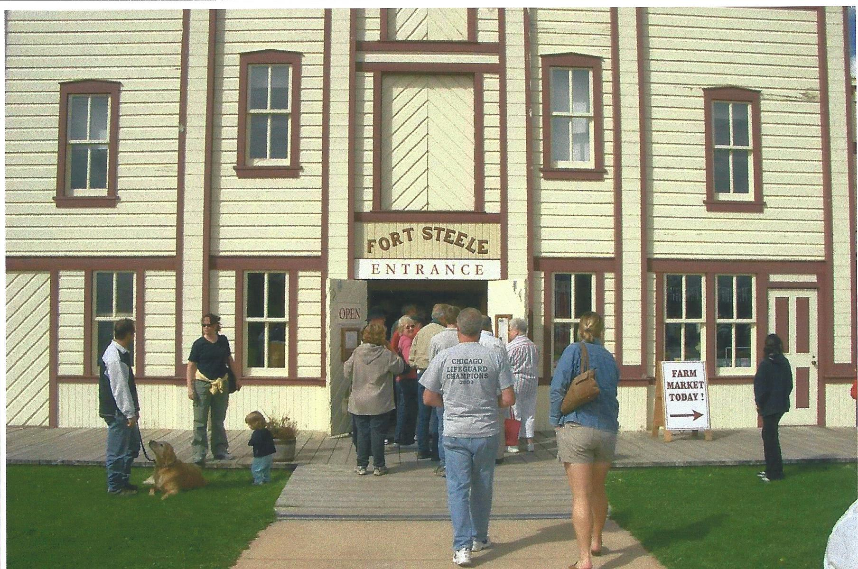
Fort Steele, BC

Slide 10
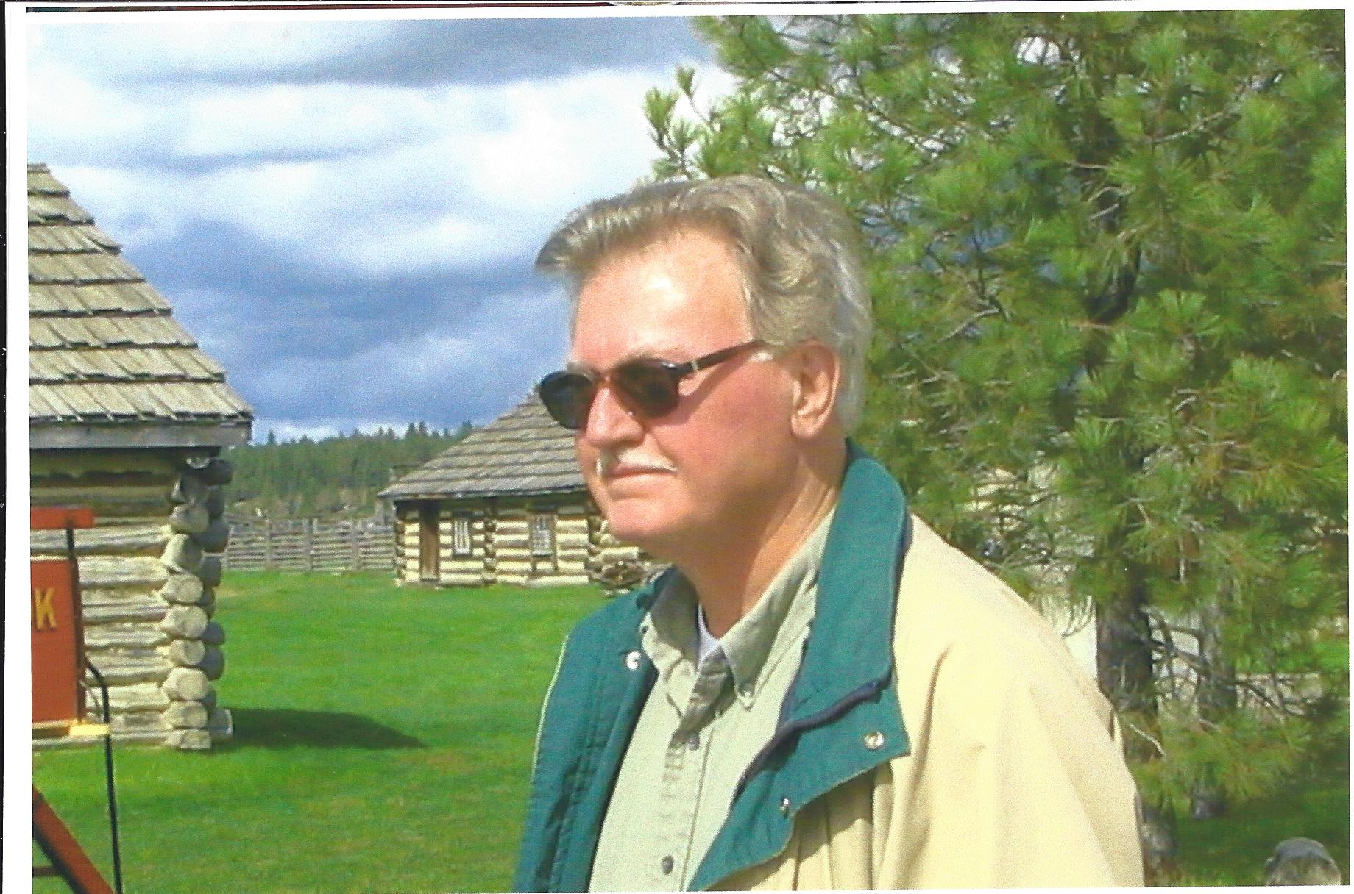
Our trouble truck driver, Hurley York

Slide 11
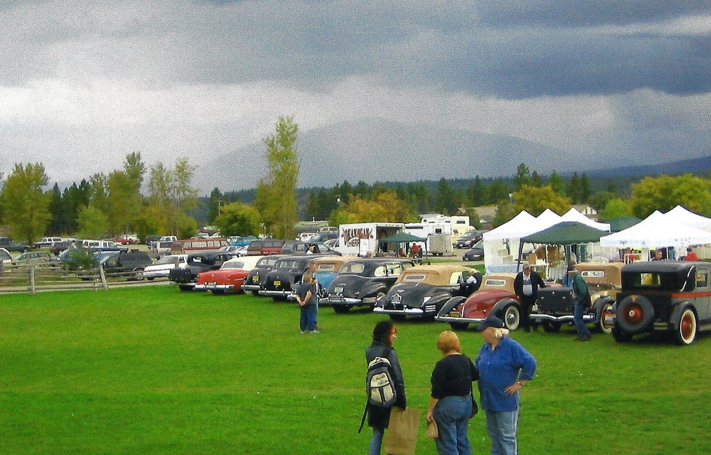
A stop at a farmer's market in Fort Steele, BC

Slide 12
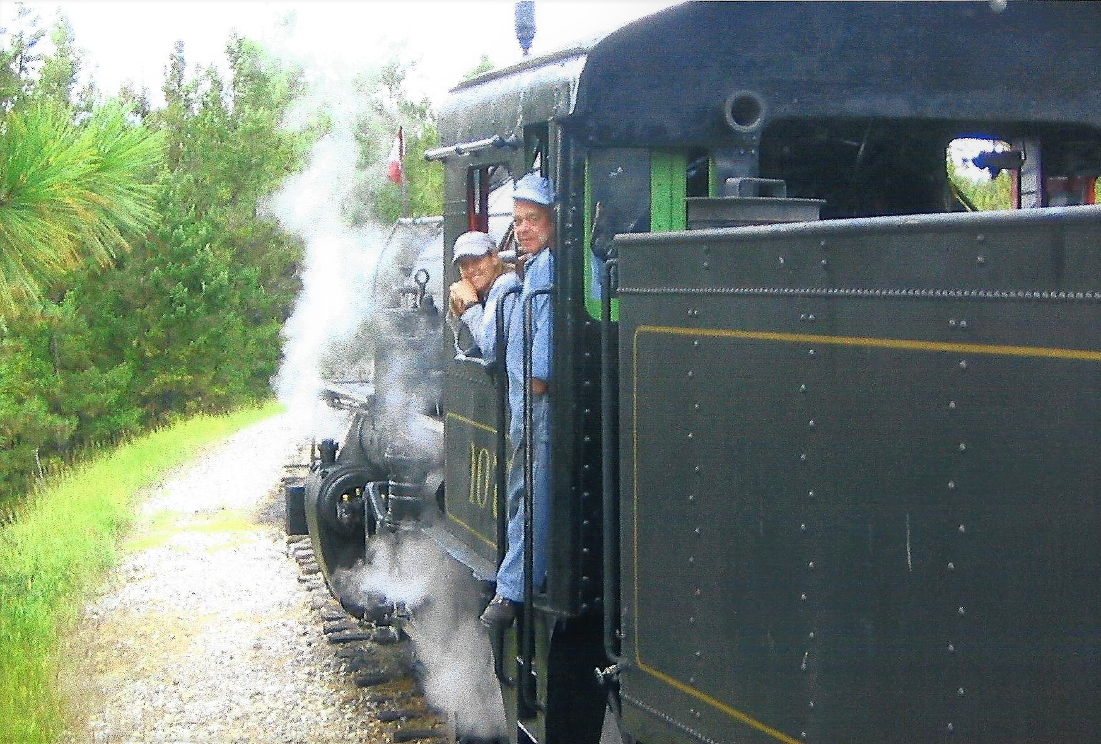
A train ride on the Kettle Valley Steam Railway, Summerland, BC

Slide 13
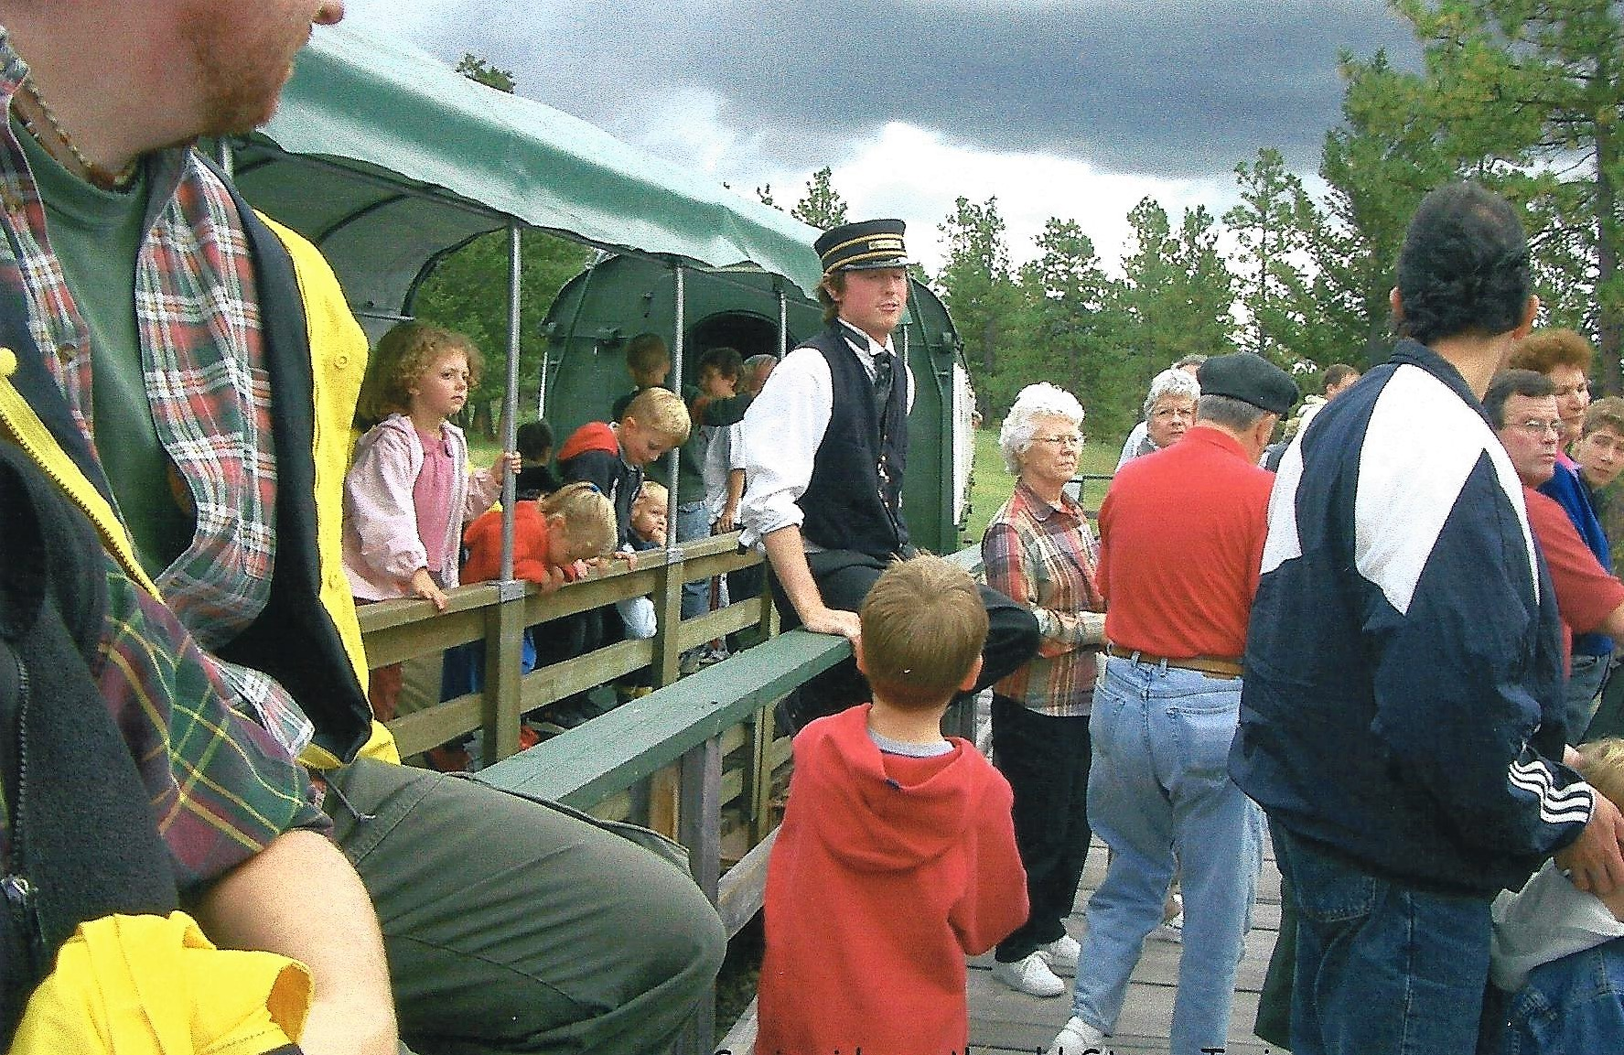
All aboard the Kettle Valley Steam Railway, Summerland, BC

Slide 14
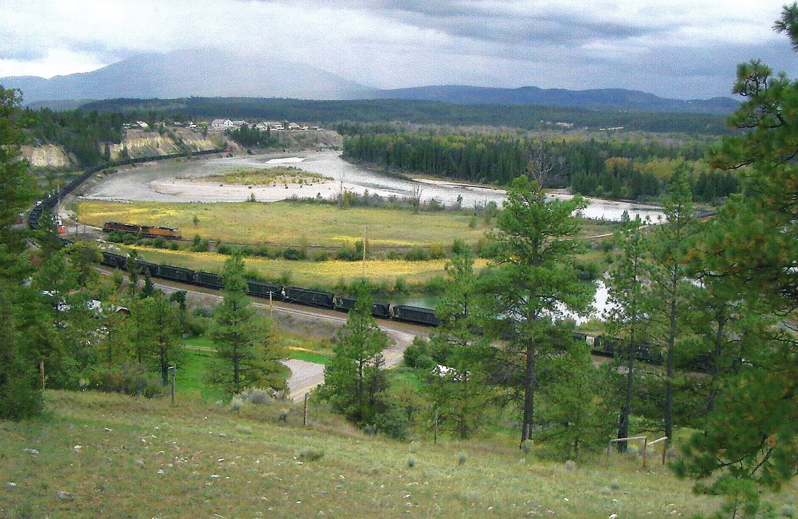
Kettle Valley Steam Railway, Summerland, BC

Slide 15
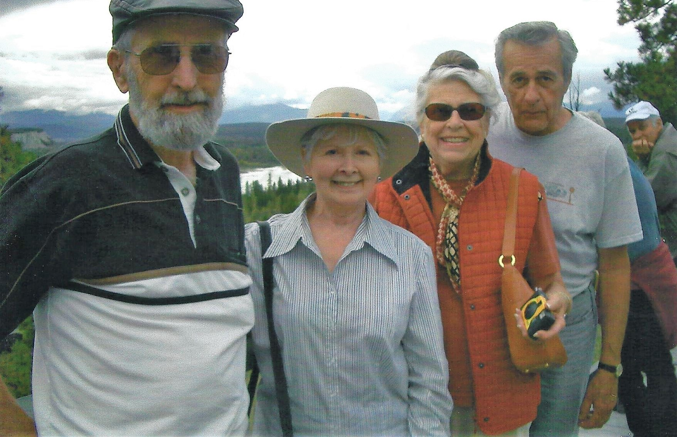
Photo opt with George, Sylvia, Beverly, and Daryl

Slide 16
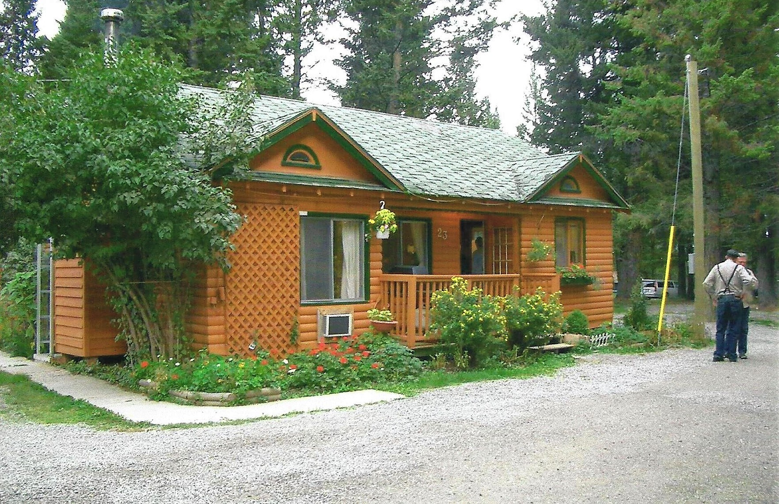
Our lodging in Fairmont Mountain Bungalows, Hot Springs, BC

Slide 17
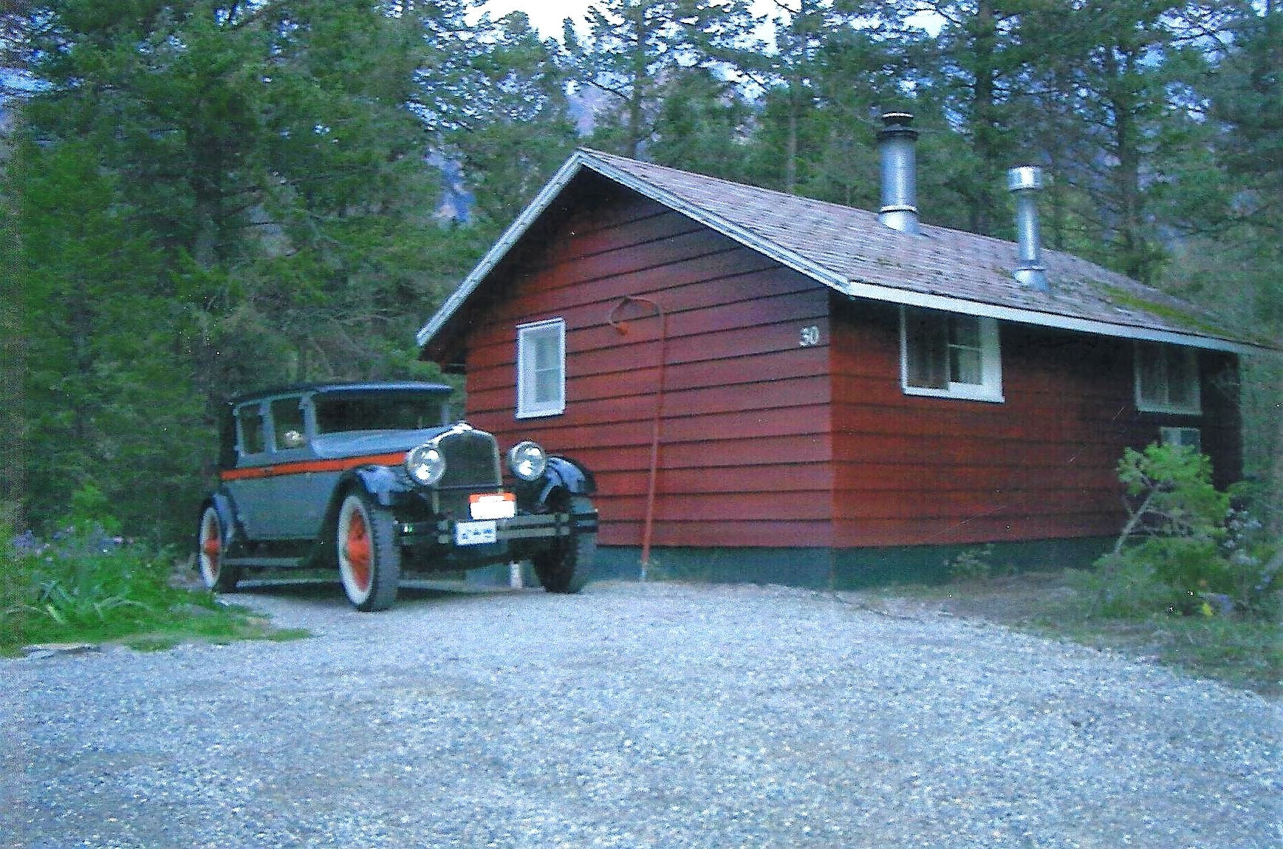
John’s 27 Stutz

Slide 18
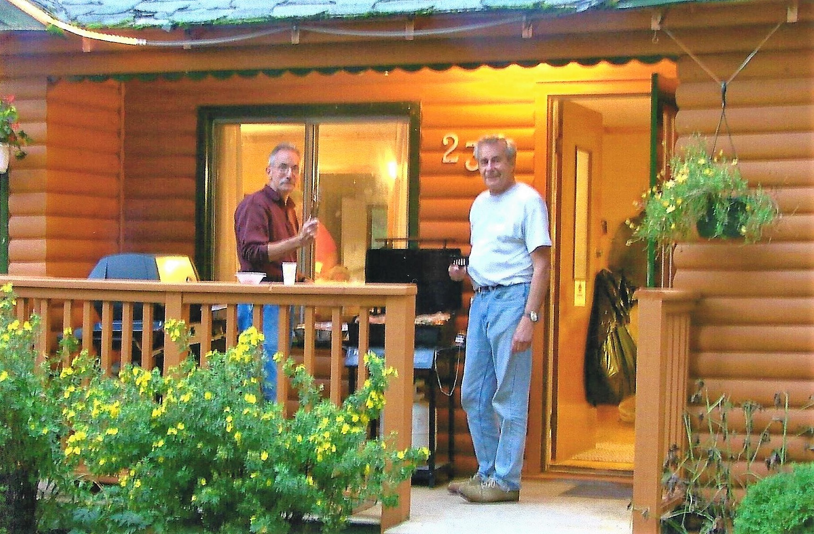
Chef Bob & Daryl preparing our dinner

Slide 19
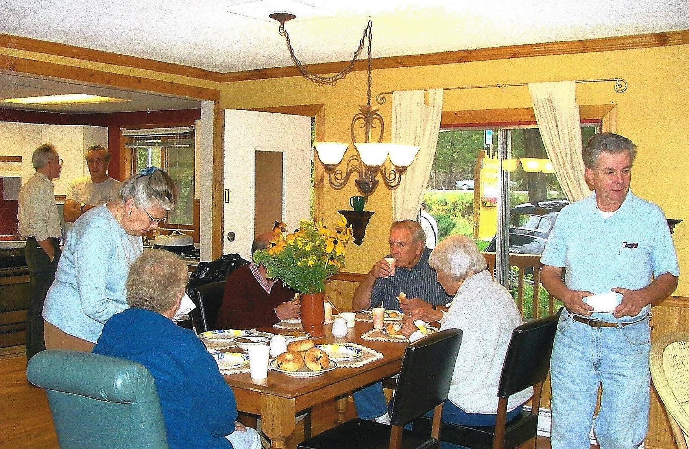
A fine meal was enjoyed by all

Slide 20
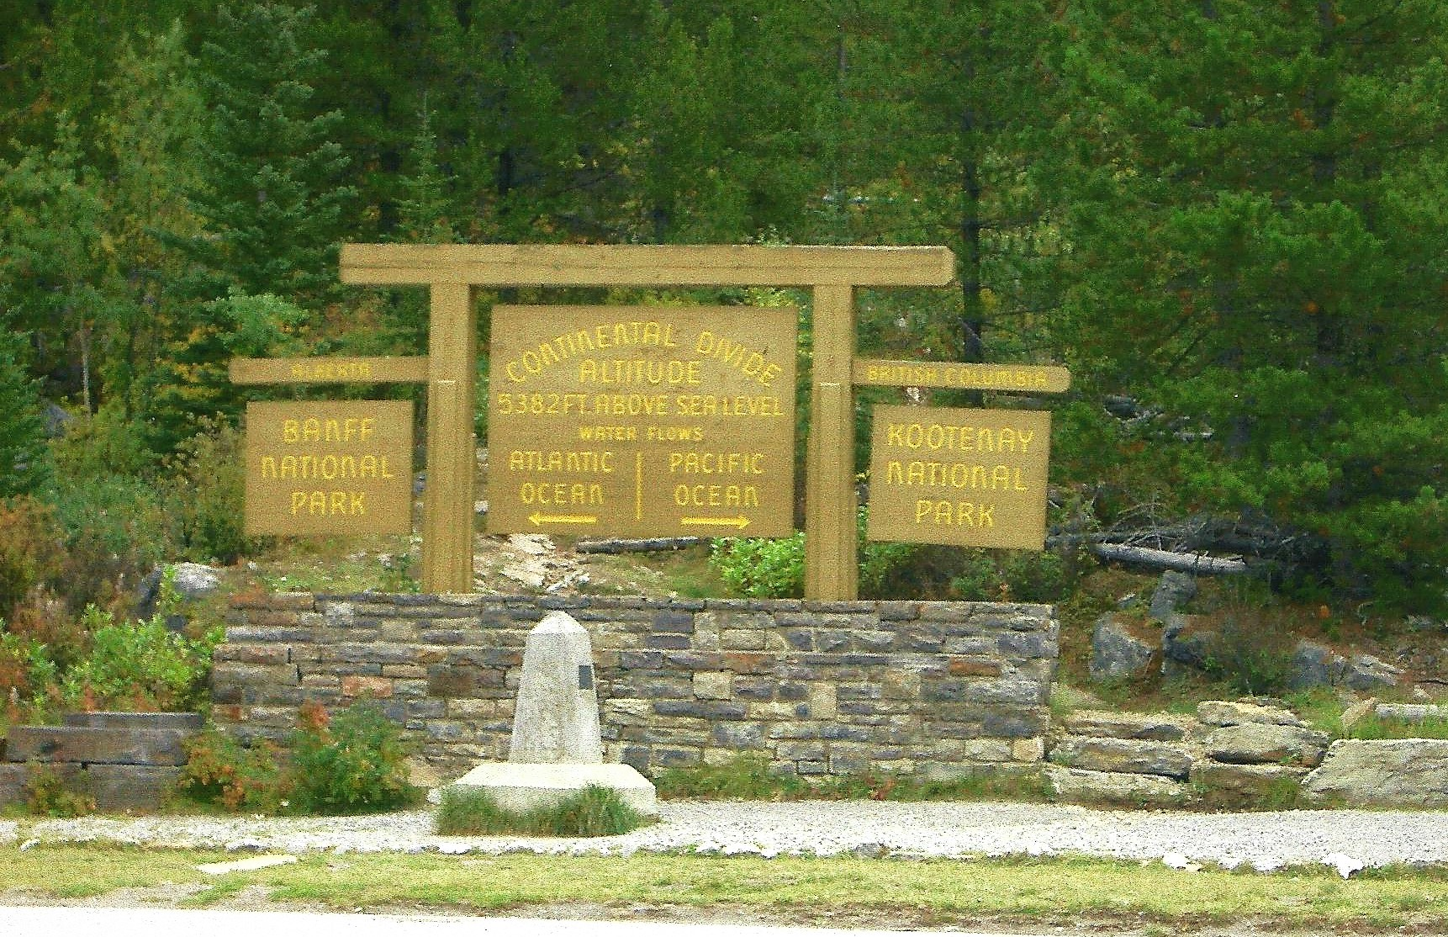
A stop at the Continental Divide

Slide 21
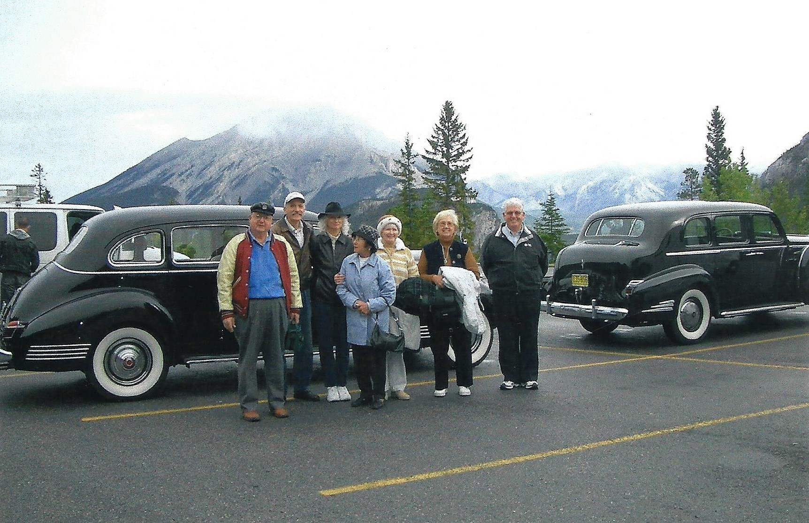
We’re on top of the mountain.

Slide 22
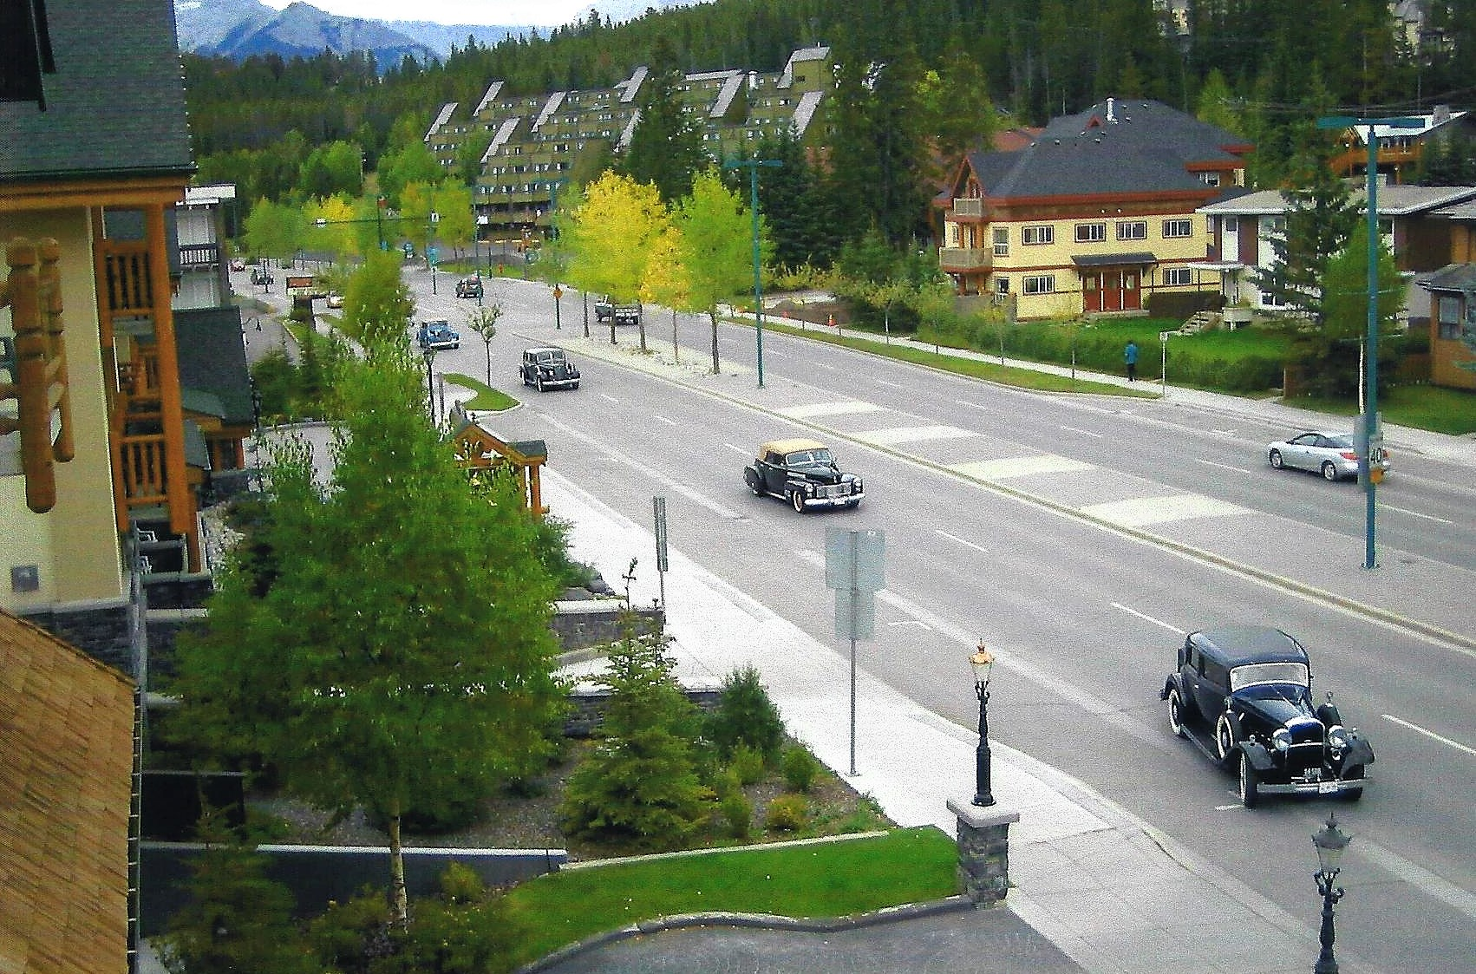
Arriving at the Rundle Stone Lodge in Banff, BC

Slide 23
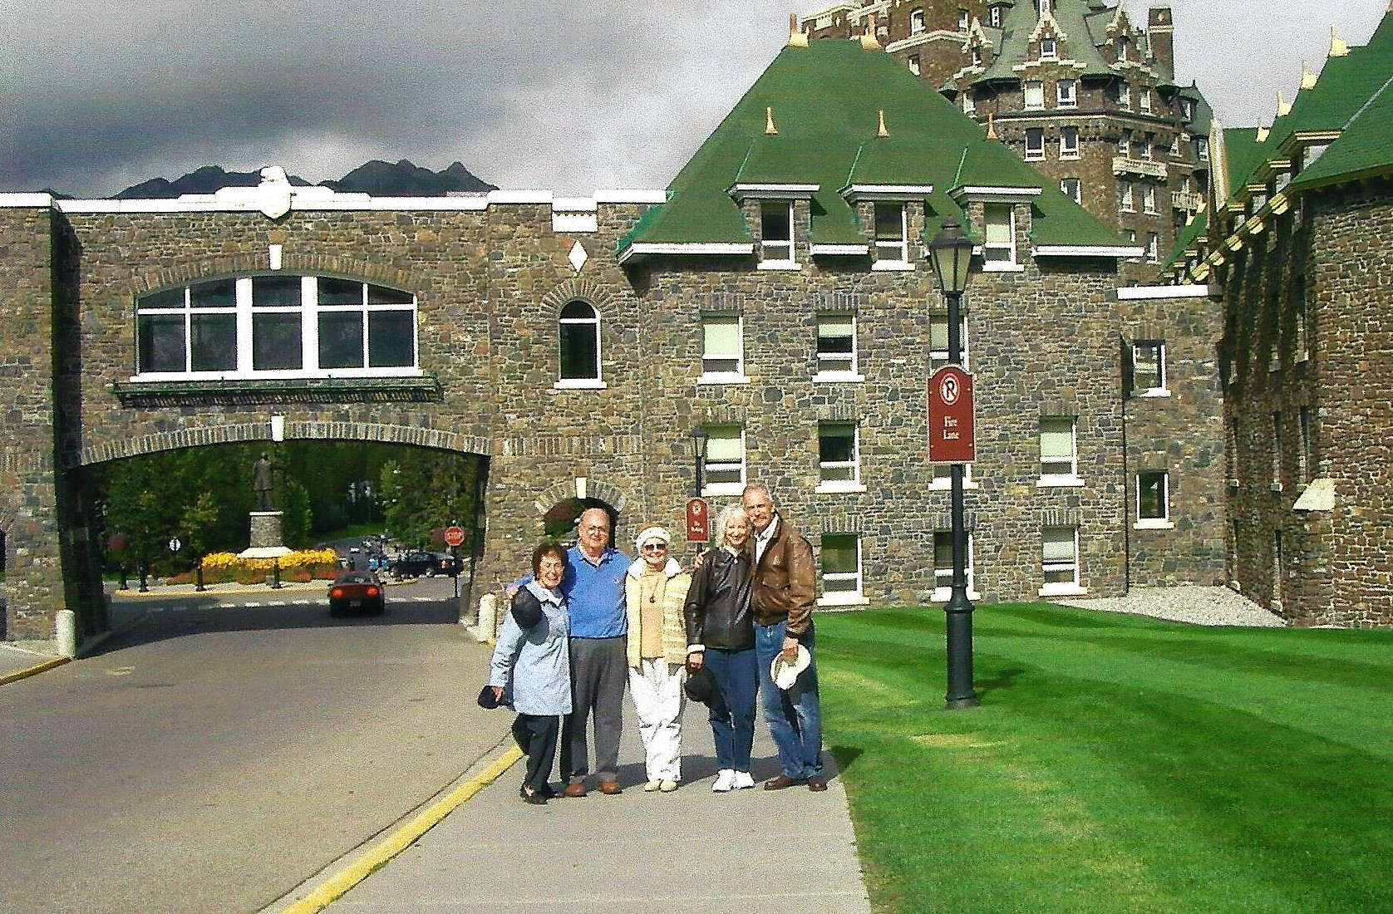
Another photo opt in front of the hotel in Banff, BC

Slide 24
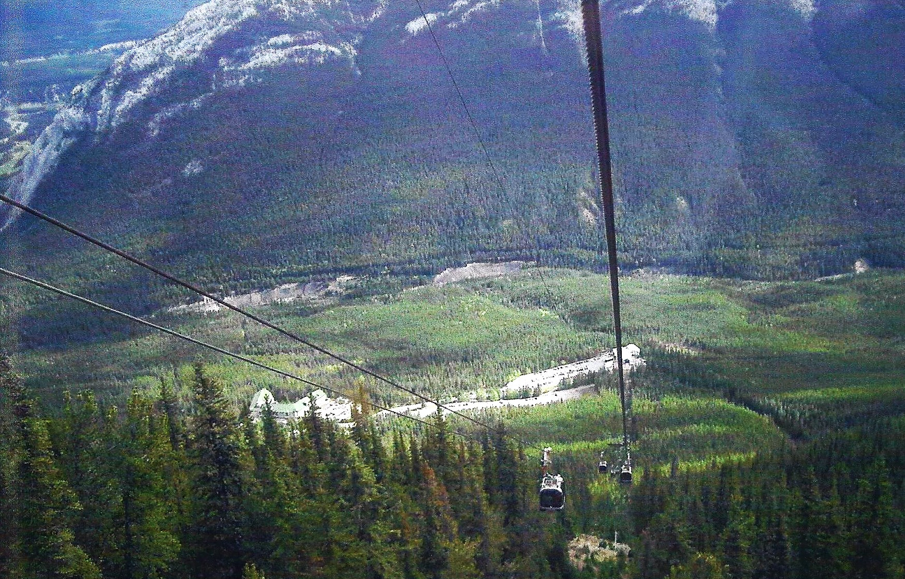
Some of us took a cable ride up on the mountain in Banff

Slide 25
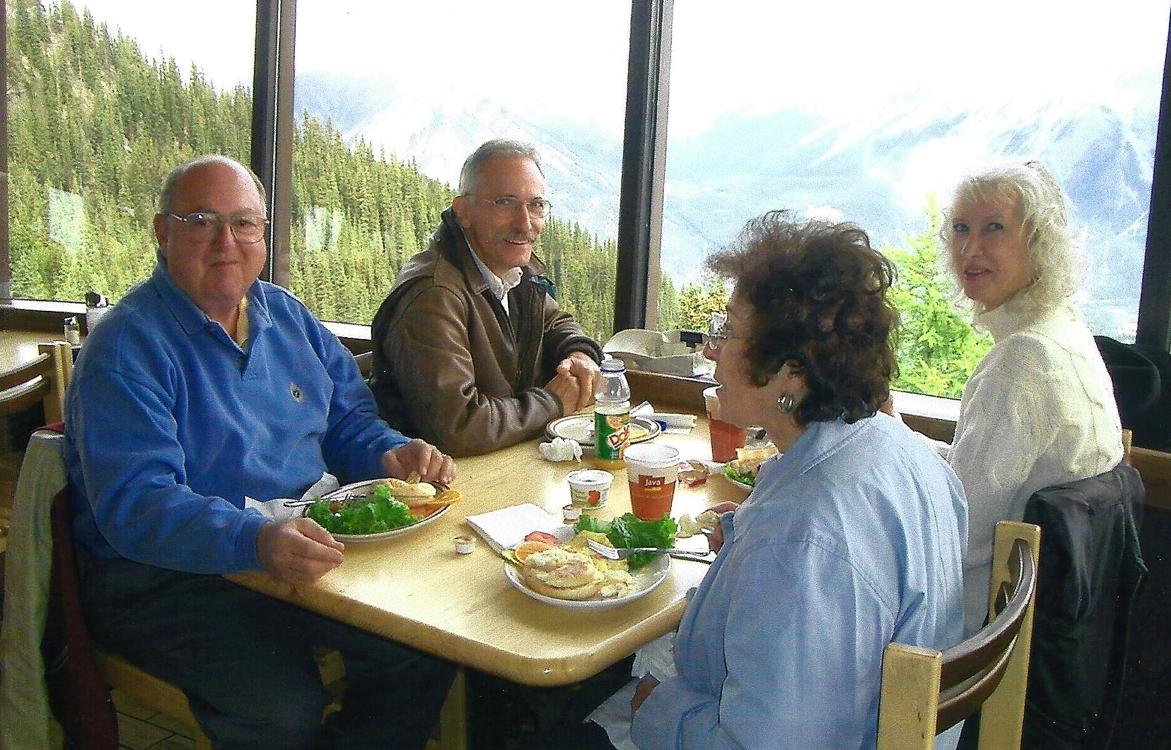
The infamous breakfast

Slide 26
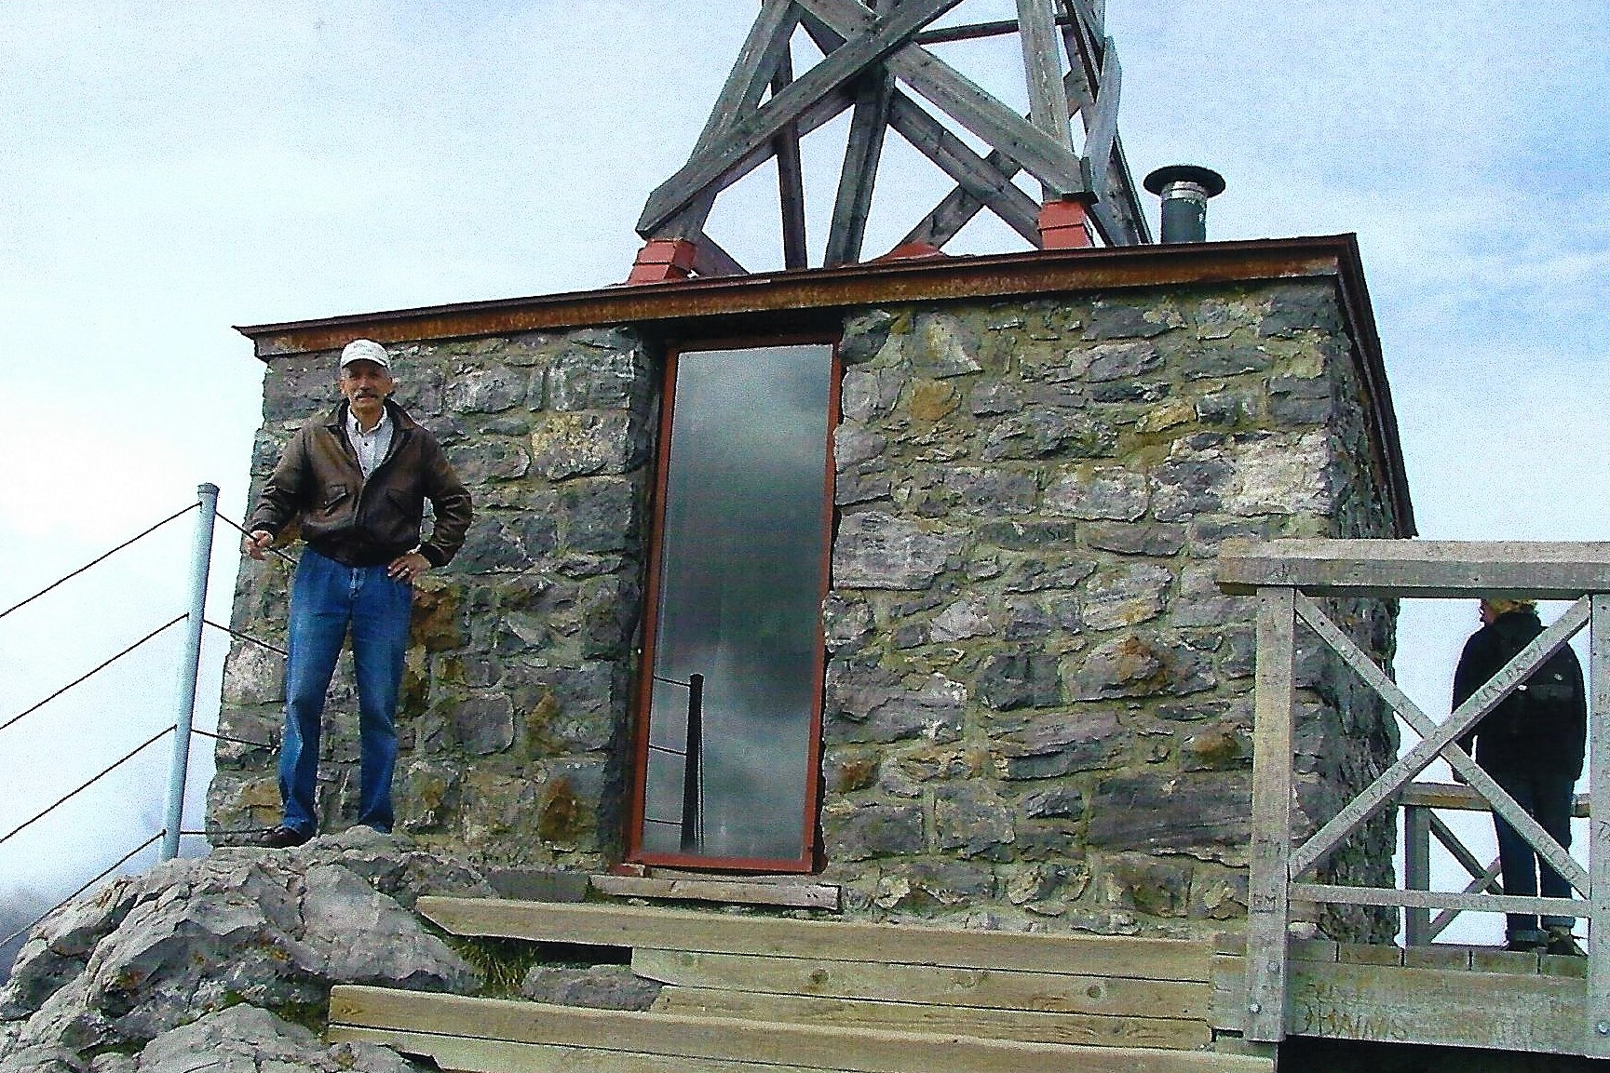
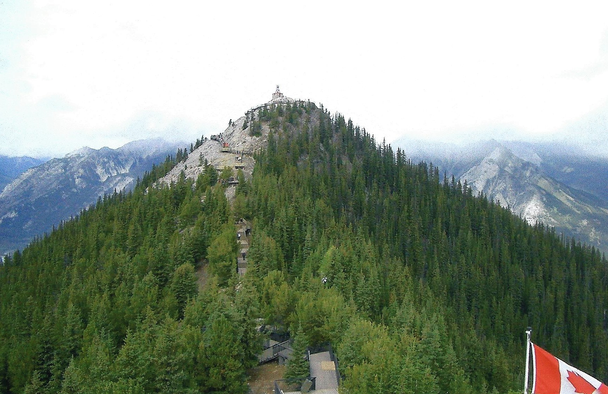
Bob wanted to go to the top, so he climbed all the way up there…

Slide 27
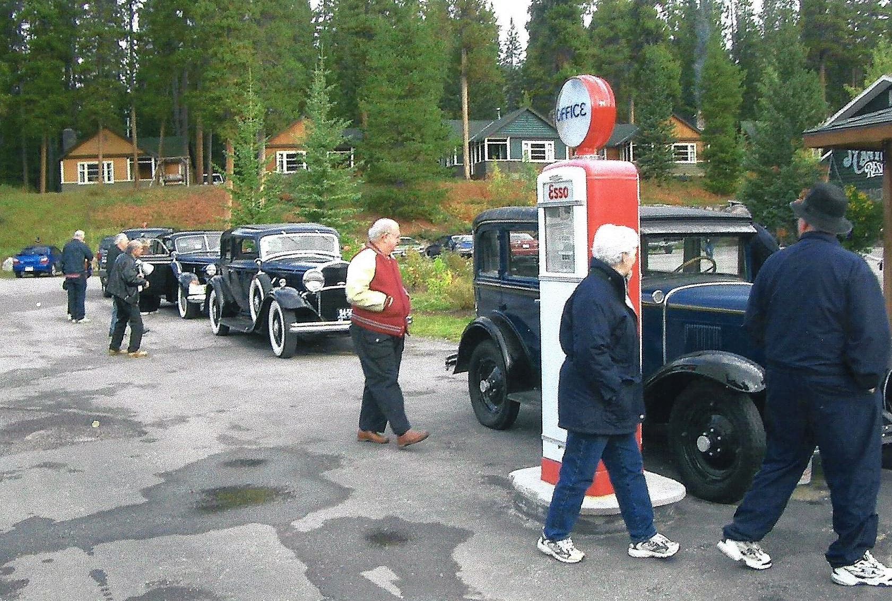
A stop at the Johnson Canyon for a hike up to the waterfall

Slide 28
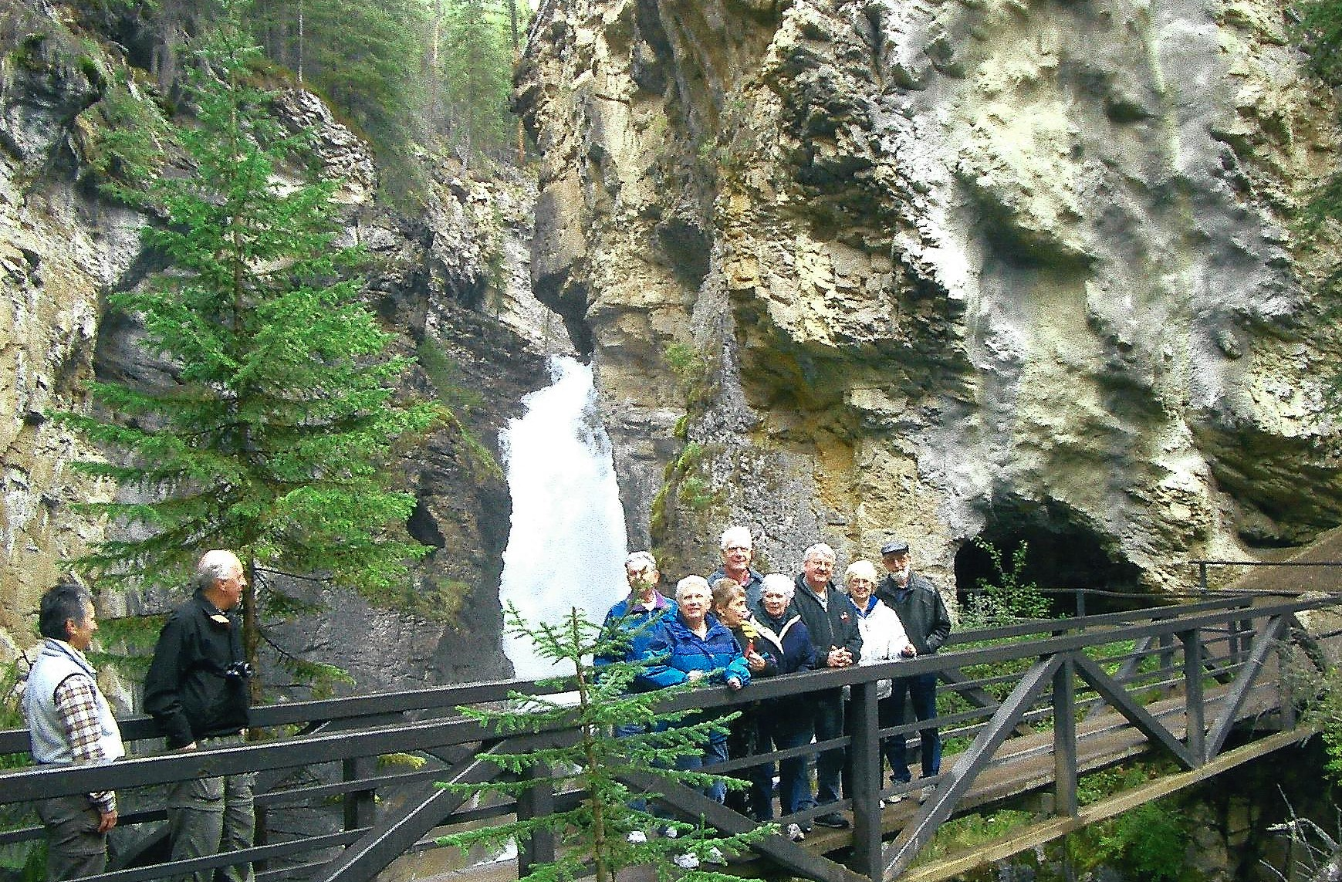
A stop at the Johnson Canyon for a hike up to the waterfall

Slide 29
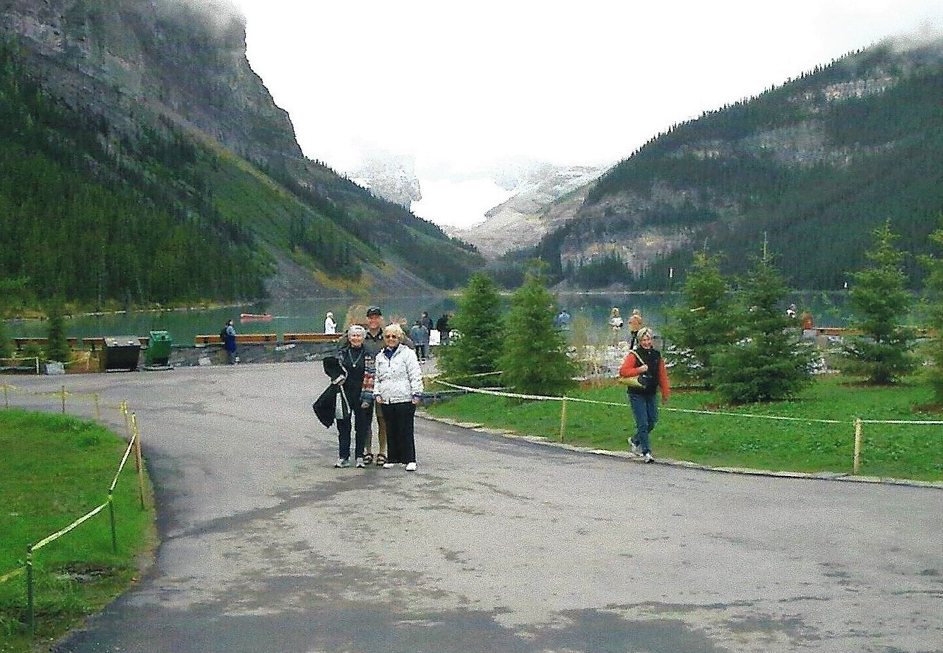
We made it to Lake Louise

Slide 30
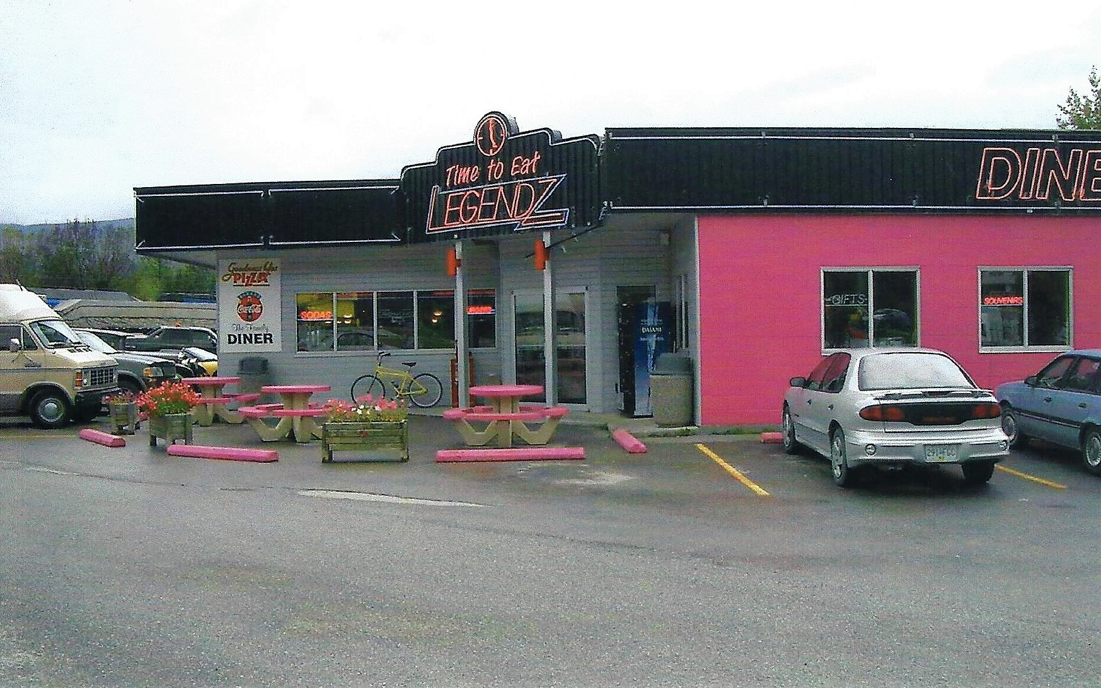
Lunch in Golden, BC

Slide 31
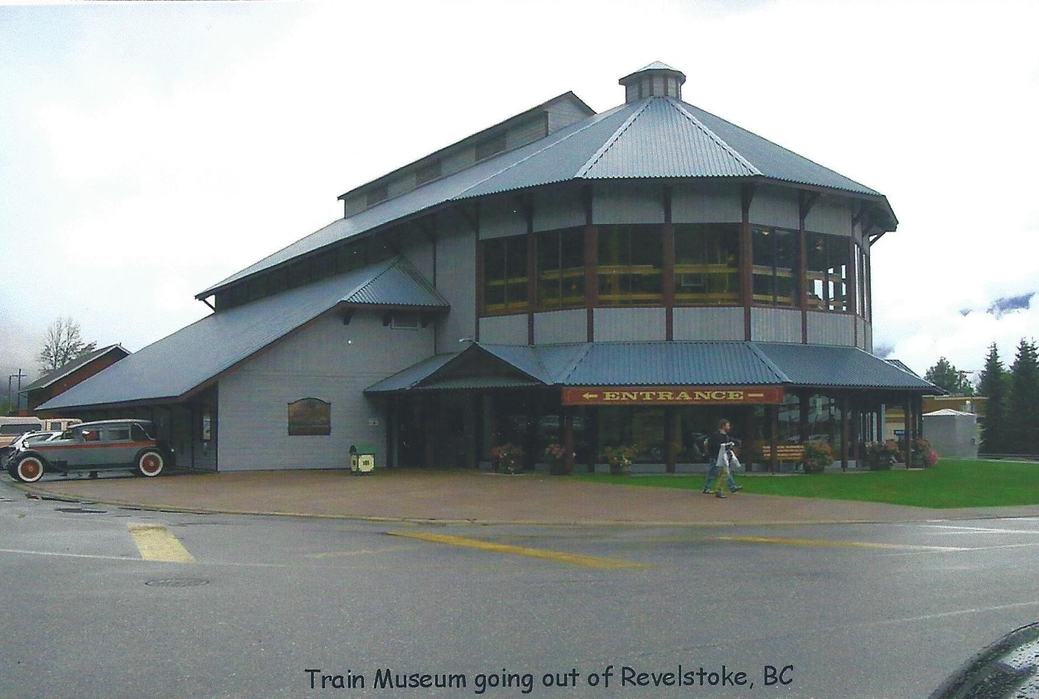

Slide 32
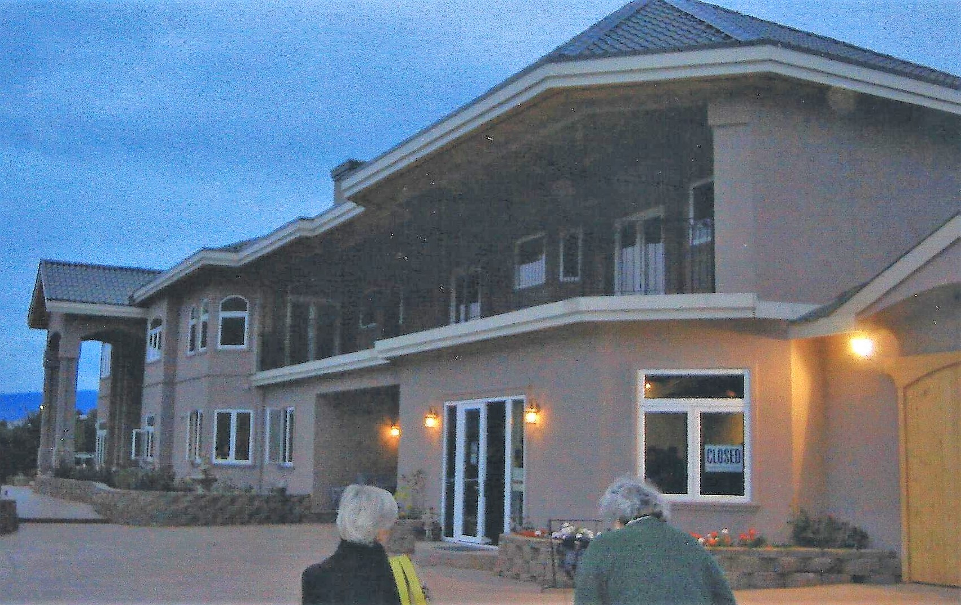
Dinner at the Sage Winery in Oliver, BC

Slide 33
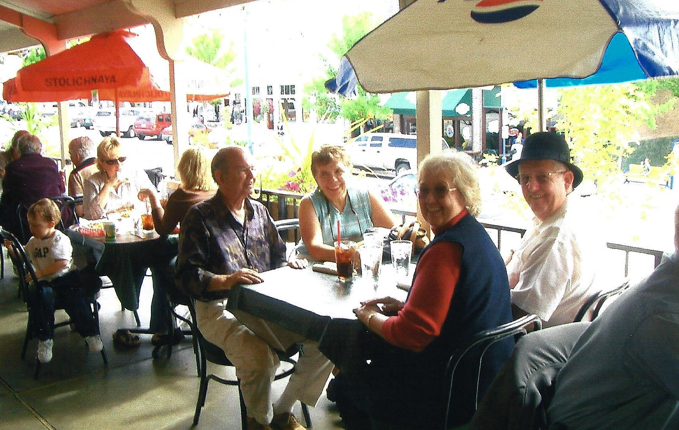
Lunch in Chelan, WA

Slide 34
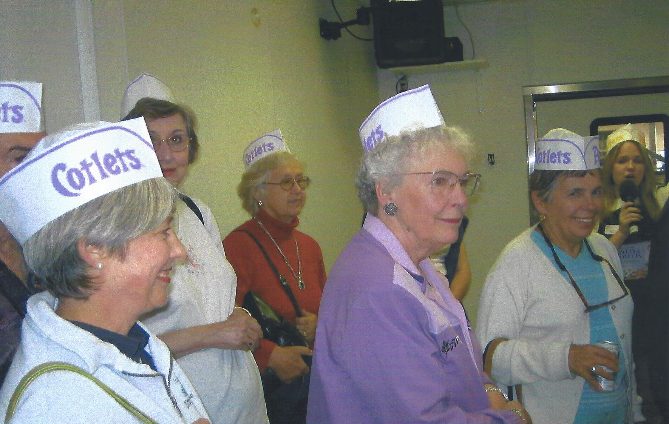
Stop at the Cotlets Candy Factory in Cashmere, WA

Slide 35
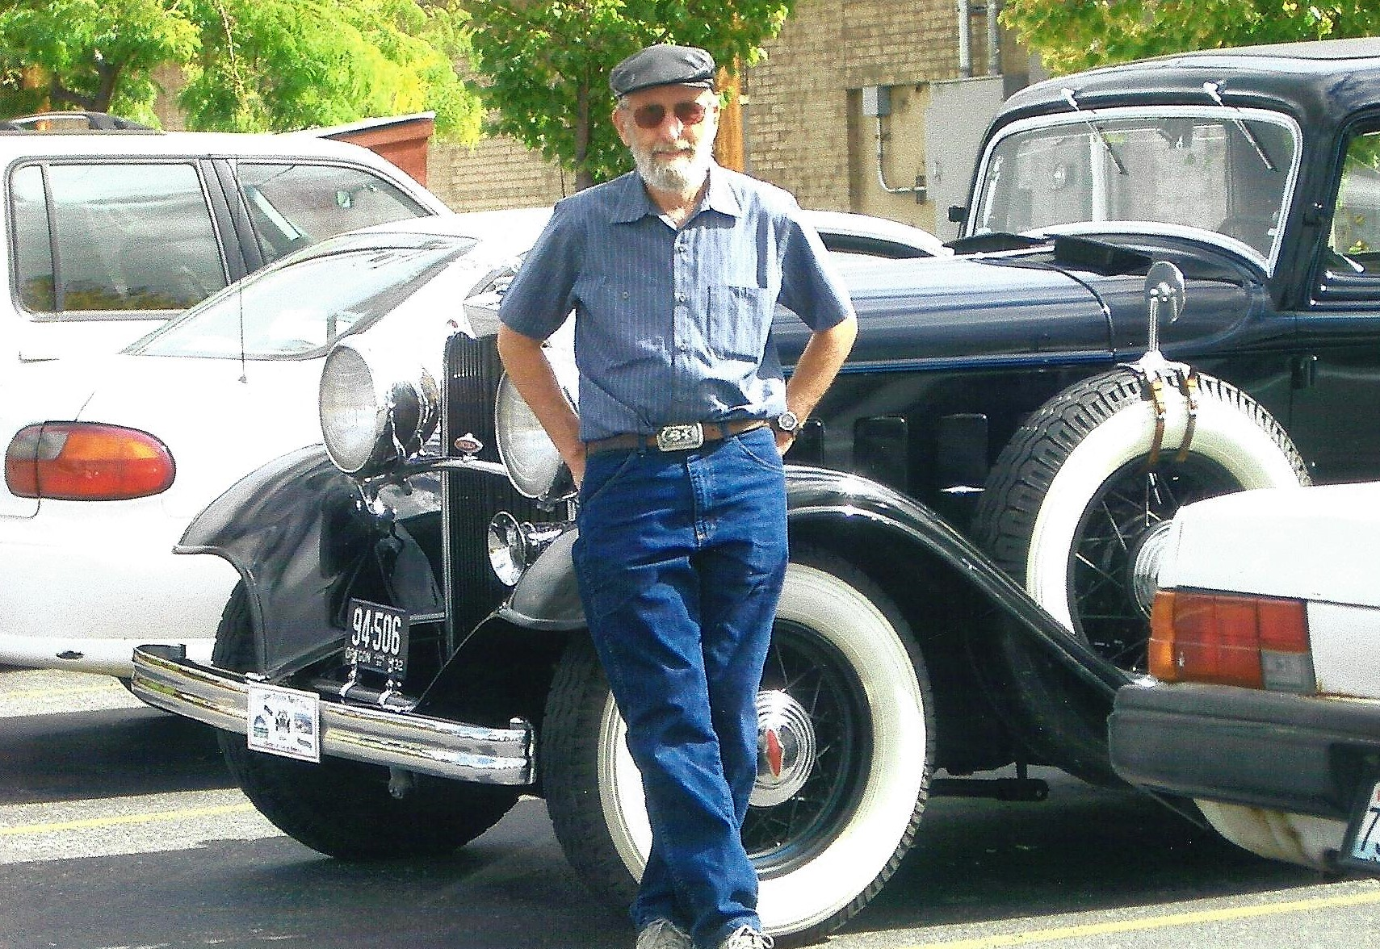
George with his 1932 Lincoln

Slide 36
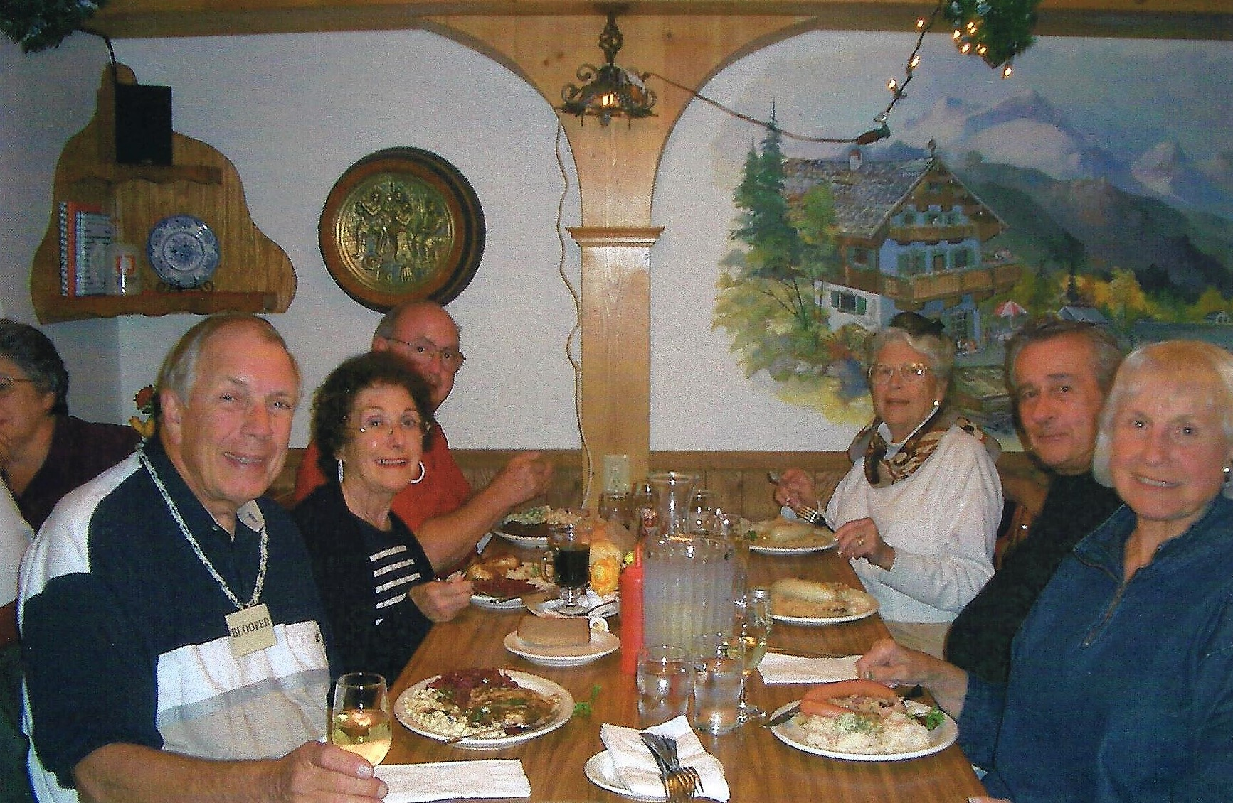
Dinner at the Andrea Keller Restaurant in Leavenworth

Slide 37
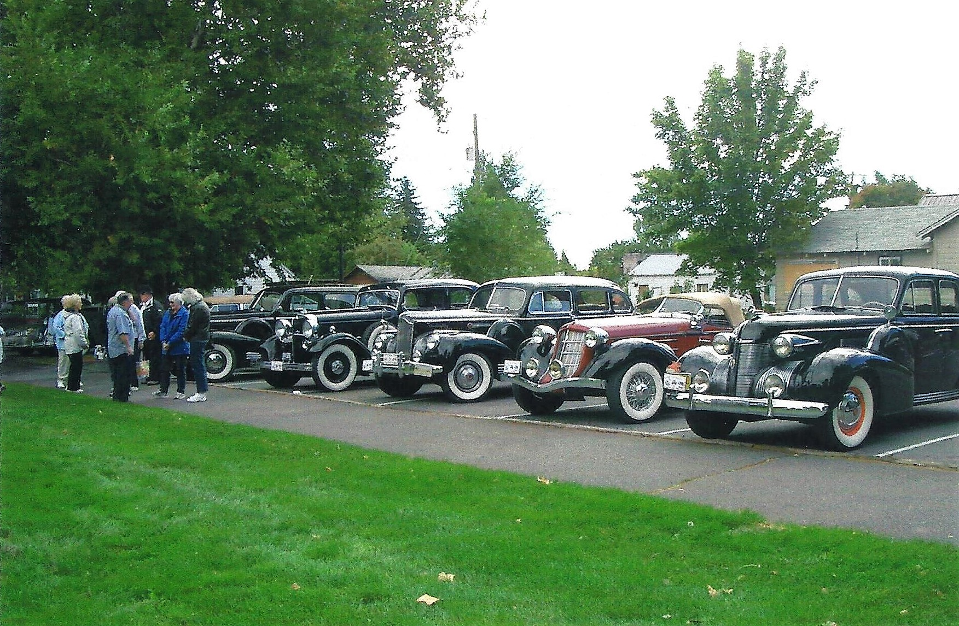
Picnic Lunch at the Naches Apple Wood Park

Slide 38
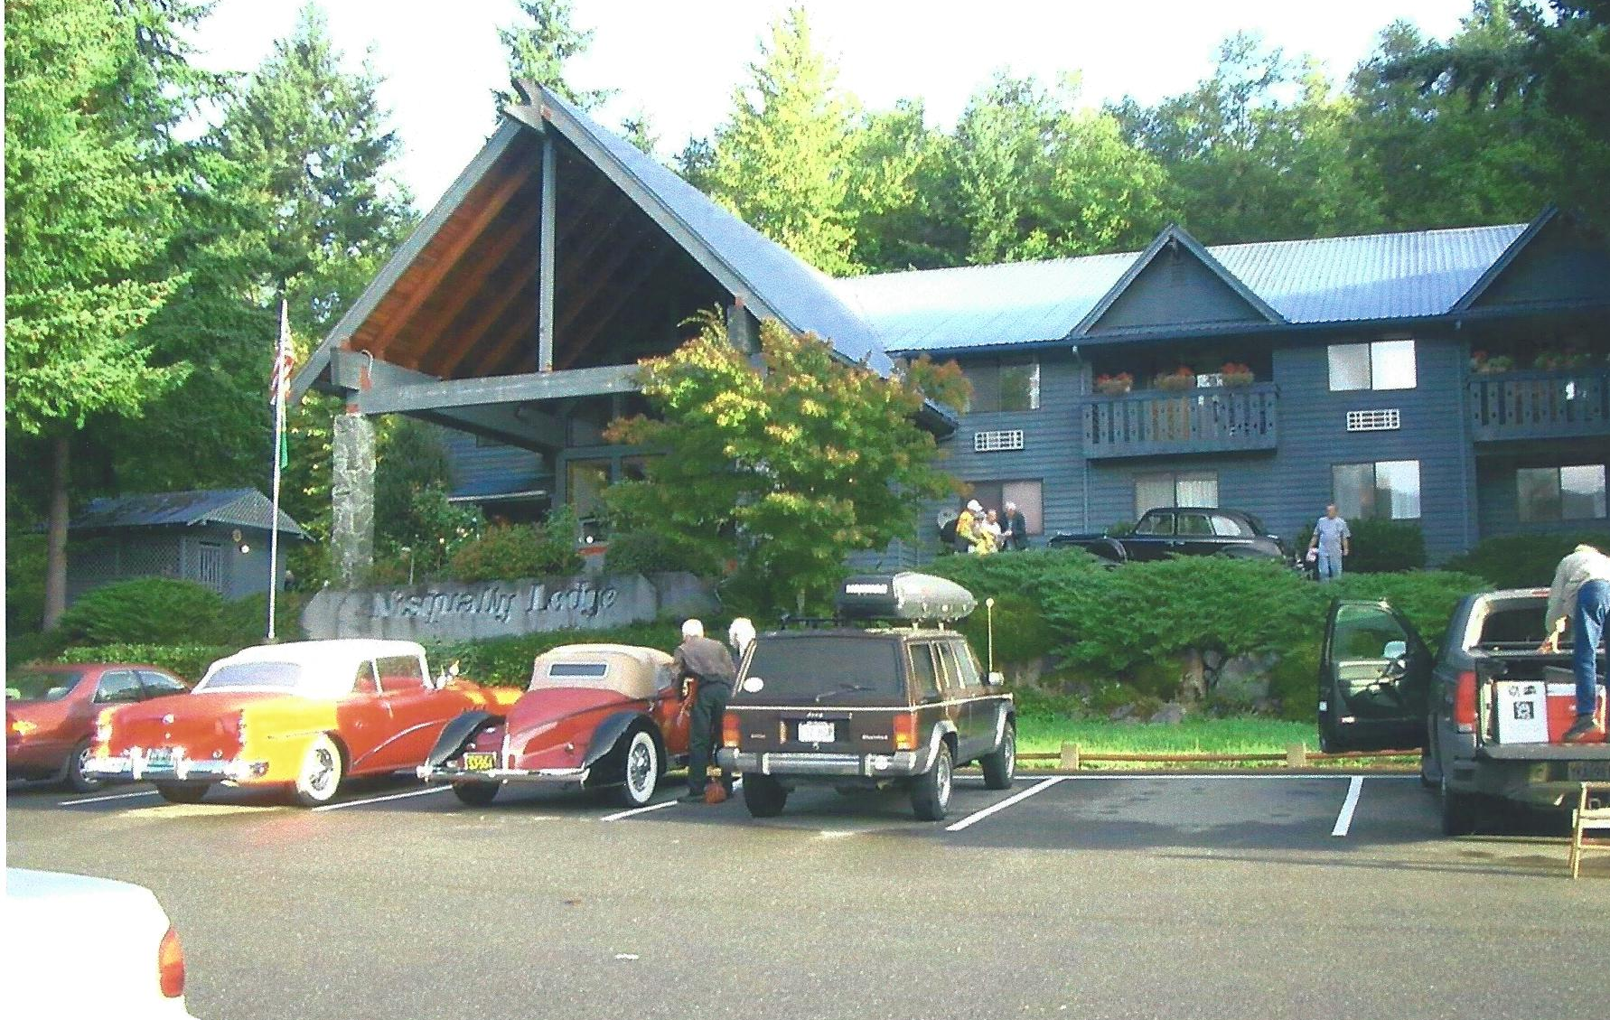
Our last night stay at the Nisqually Hotel in Ashford, WA

Slide 39
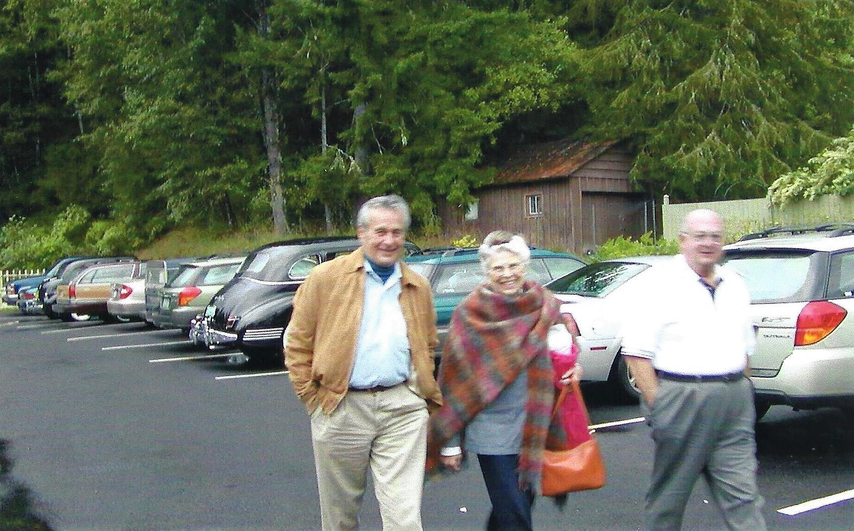
All spiffed up for the awards dinner

Slide 40
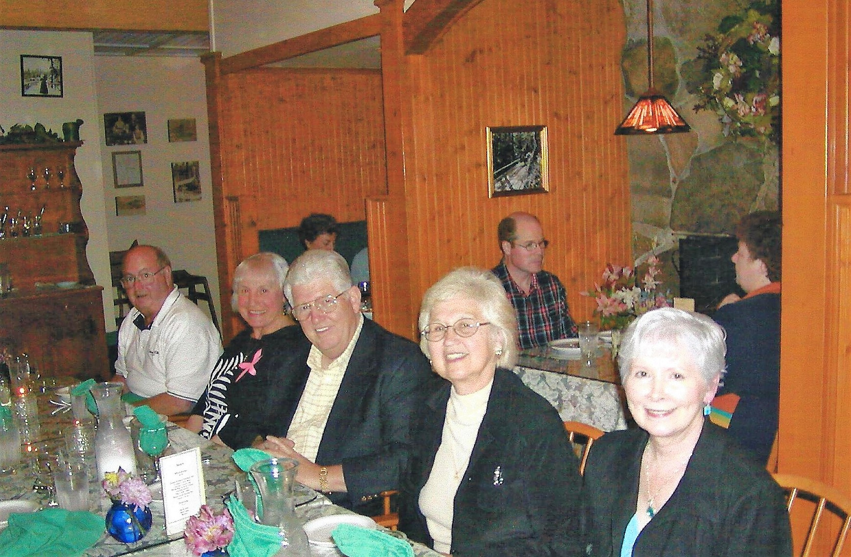
Awards dinner at the Alexandra Restaurant in Ashford

Slide 41
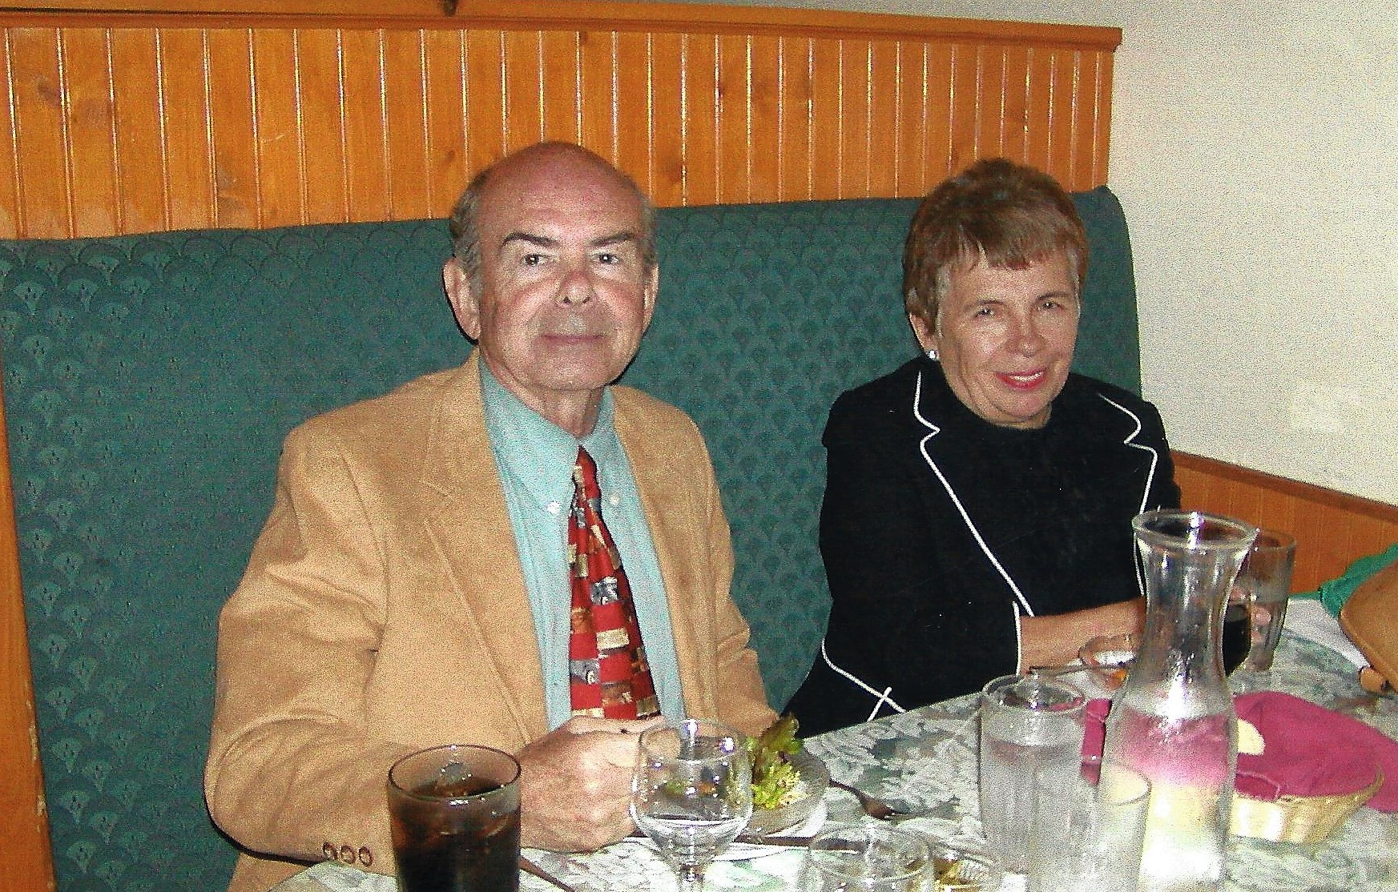
Rodger & Jan looking good

Slide 42
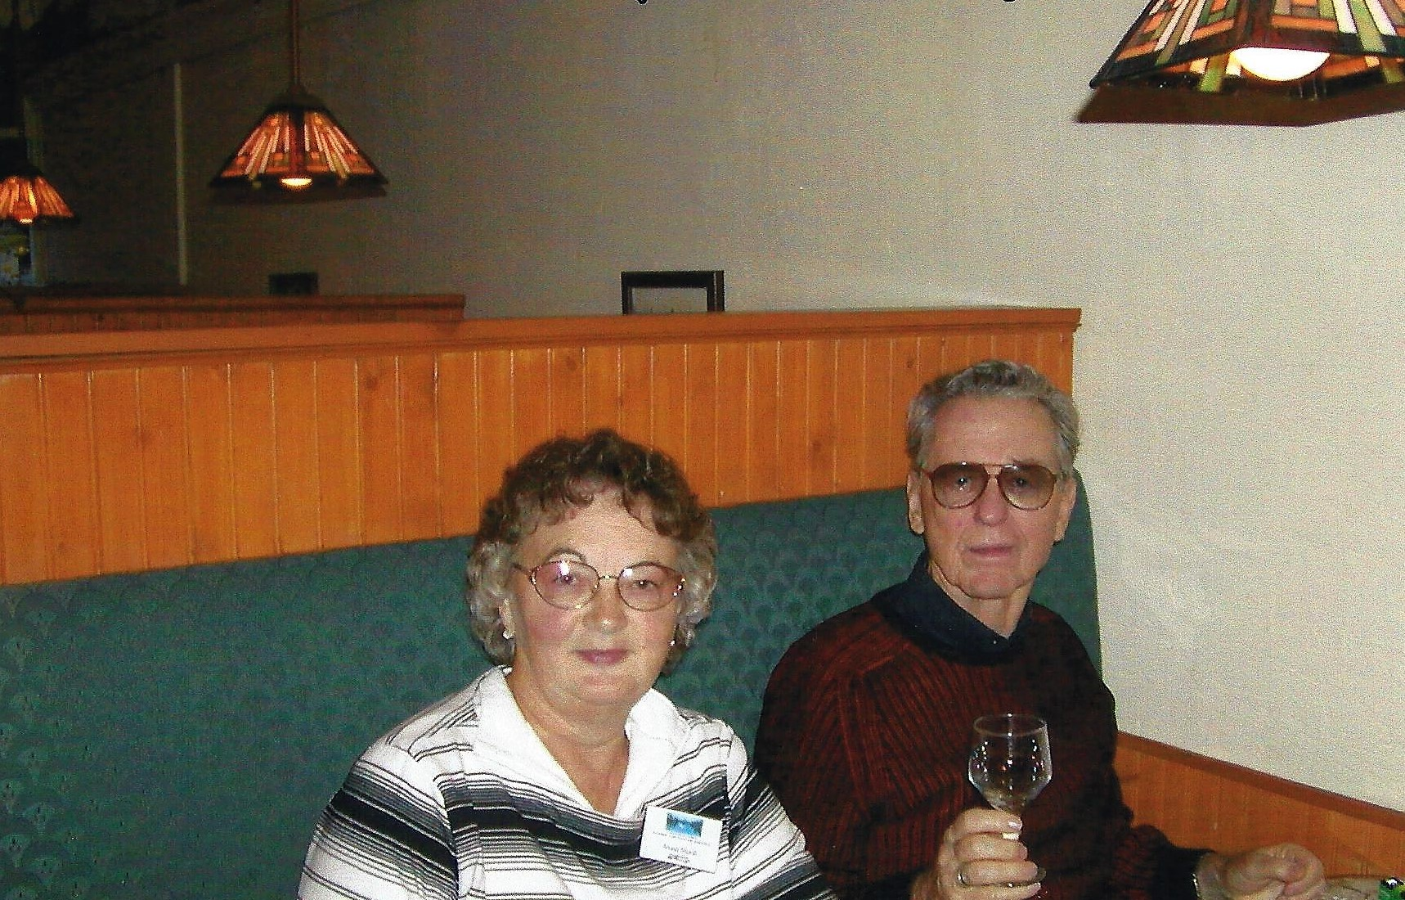
Mona & Sherman joined us for dinner

Slide 43
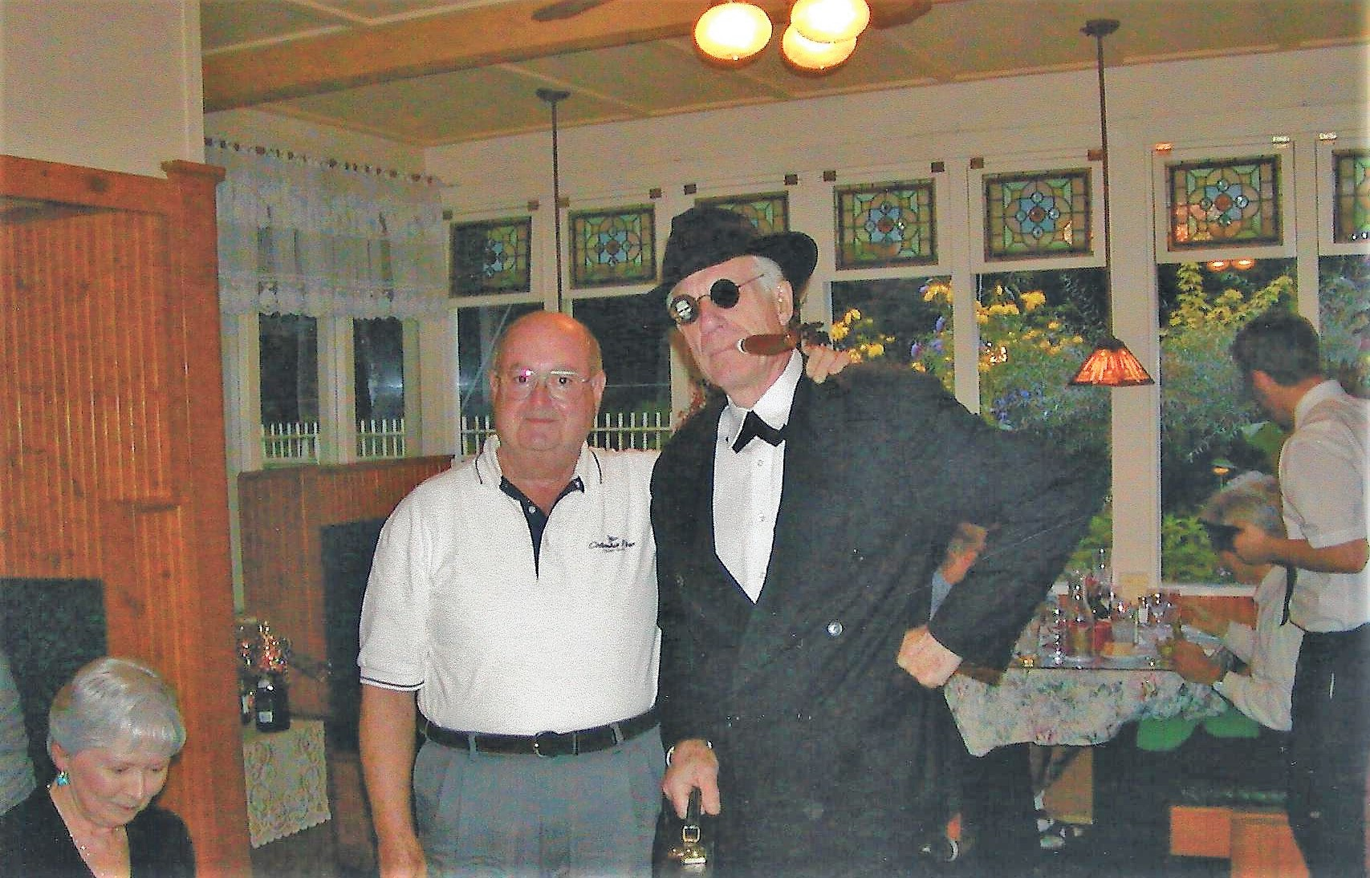
So Al Capone made it after a bit of a detour

Slide 44
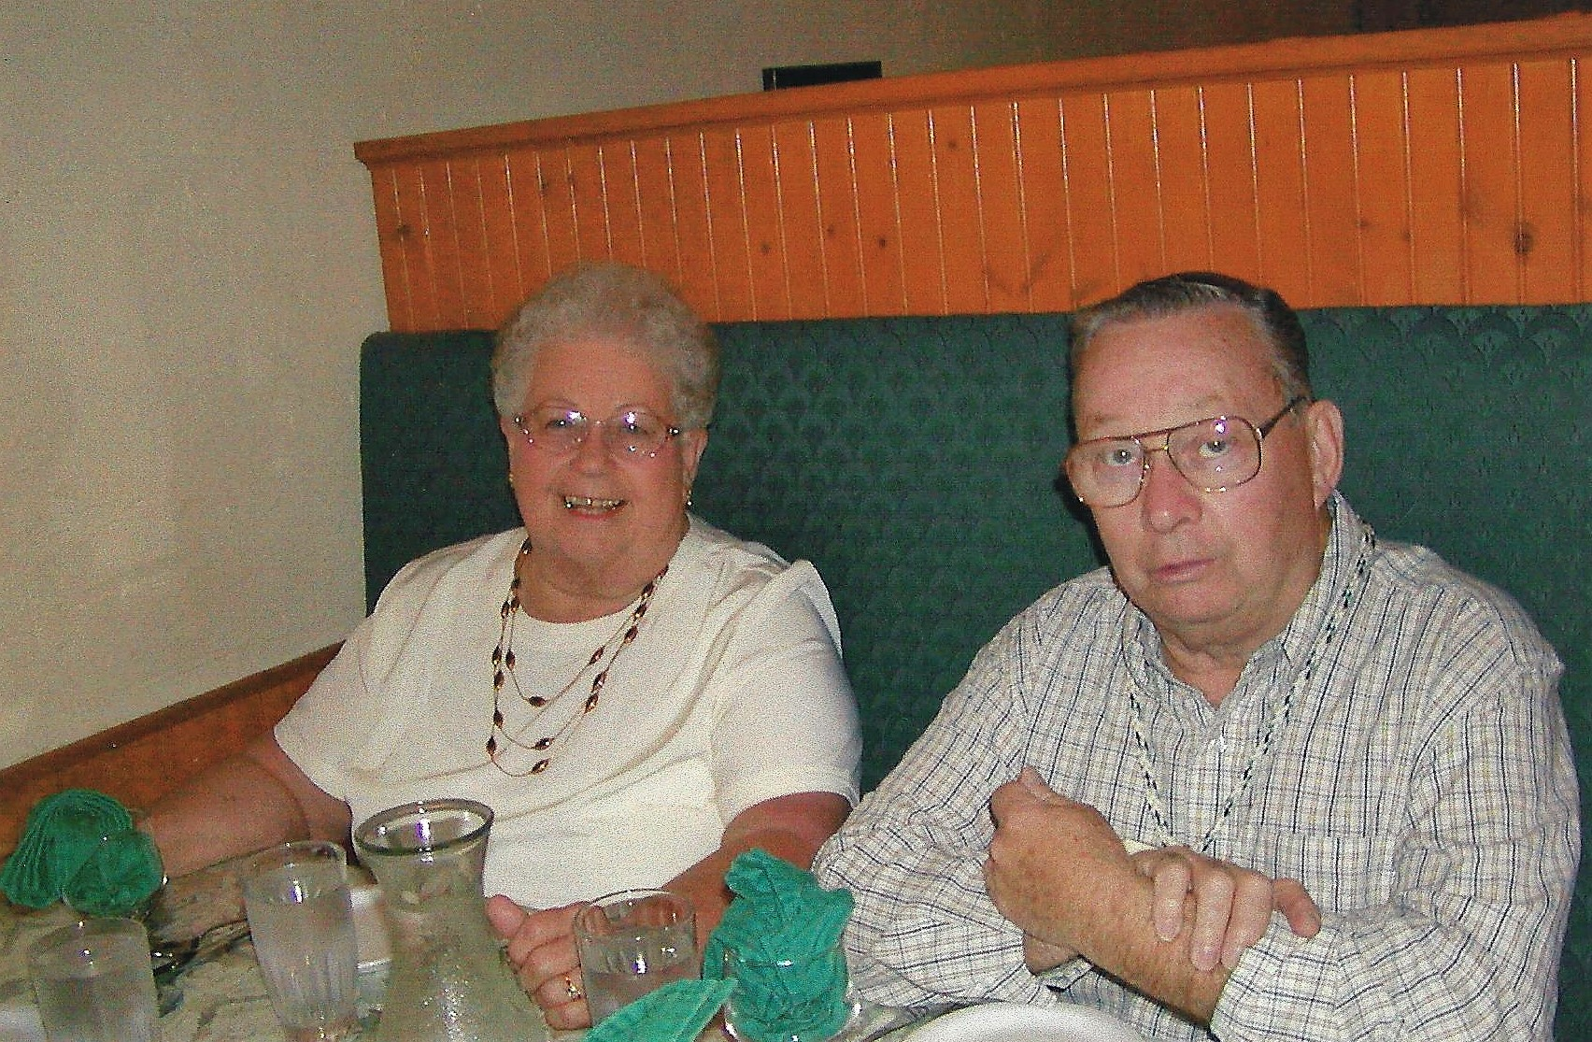
Gene & Lois

Slide 45
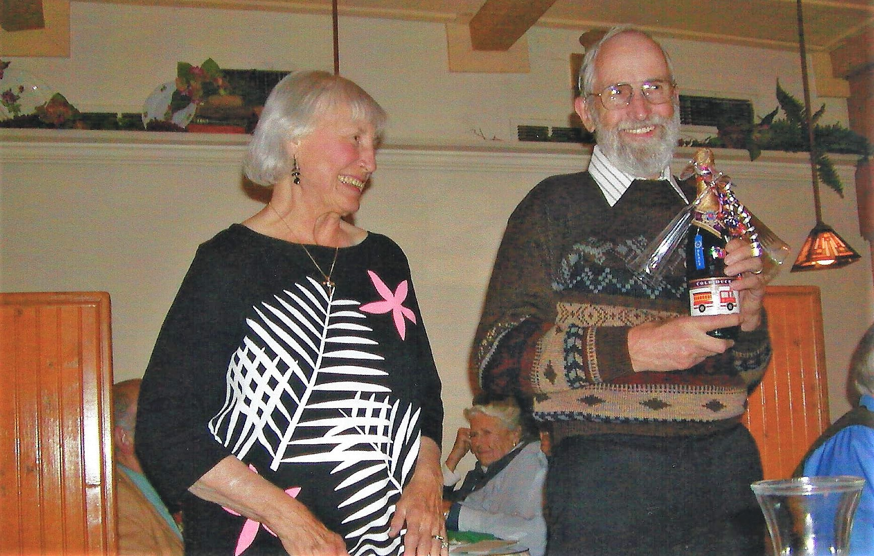
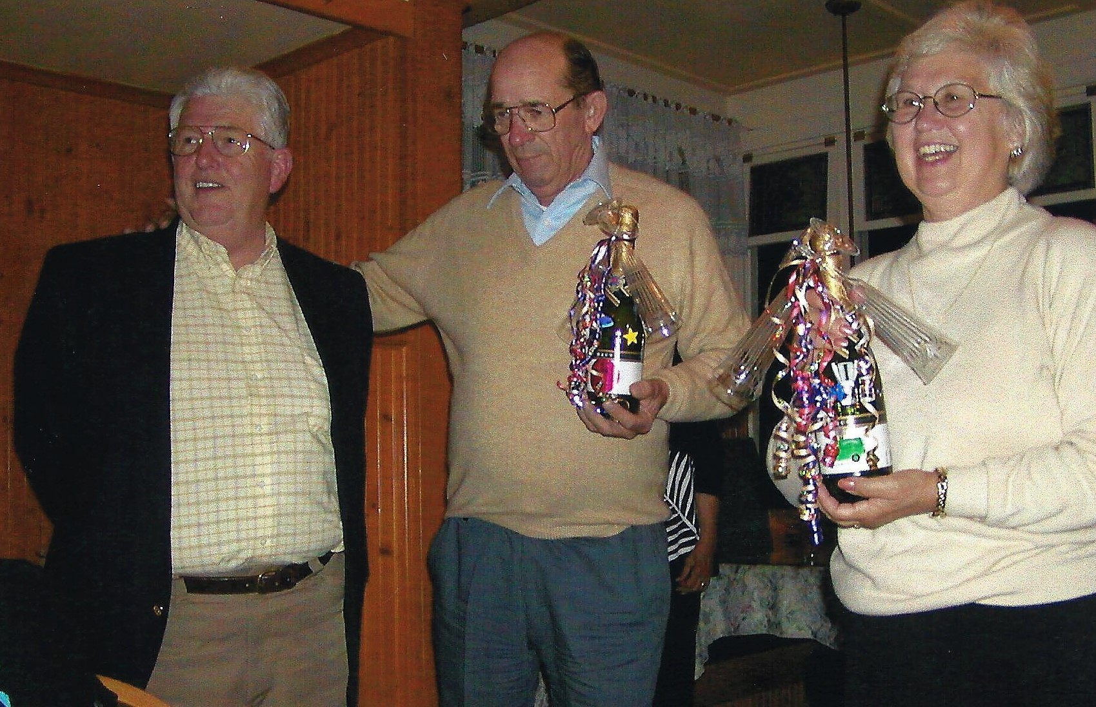
And the final, the Bubbly Awards by Jerry and June

Slide 46
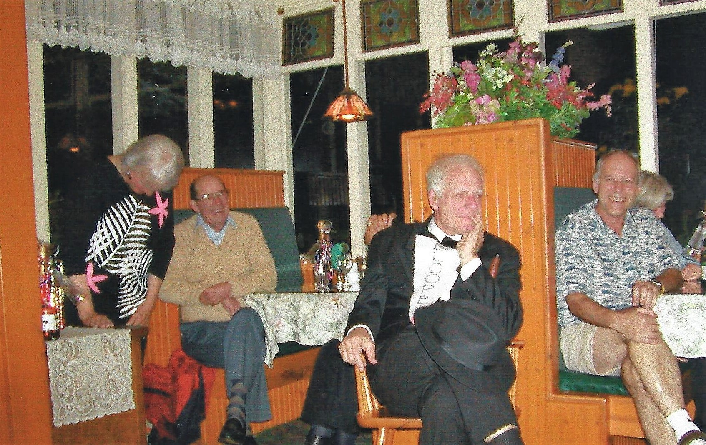
I can’t believe they gave me the Blooper

Slide 47
What a fun tour.. Do join us again next year.

